Slide 1
Notes:
The Behavior/Mental Health Technical Assistance Center is funded by West Virginia
Department of Education’s Office of Special Education and is housed at the Autism Training
Center at Marshall University. The center was created as a response to local outcry for supports
with issues related to student behavior/mental health needs as well as the need to improve the
continuity of existing interventions in schools. The center offers training and technical
assistance in a variety of areas. The interventions supported by the center are based upon the
national models and research related to multi-tiered systems of support (MTSS) and
interconnected systems framework (ISF)

Slide 2
Collaboration
Notes:
The Behavior/Mental Health Technical Assistance Center is funded by West Virginia
Department of Education’s Office of Special Education and is housed at the Autism Training
Center at Marshall University. The center was created as a response to local outcry for supports
with issues related to student behavior/mental health needs as well as the need to improve the
continuity of existing interventions in schools. The center offers training and technical
assistance in a variety of areas. The interventions supported by the center are based upon the
national models and research related to multi-tiered systems of support (MTSS) and
interconnected systems framework (ISF)

Slide 3
RECLAIM WV
“West Virginia’s students are suffering from the fallout of the opioid epidemic engulfing the state’s adults. The trauma these children are experiencing at home is affecting not only their ability to learn, but their entire lives. Violent and erratic behavior –most likely a response to toxic stress – is increasing in frequency, duration, and intensity, especially among younger children. In today’s classrooms, teachers and administrators are having to address students’ most basic physical, mental, social-emotional, and behavior health needs before they can provide classroom instruction, causing additional burdens on educators and staff already stretched to capacity.”

Slide 4
Why a Behavior/Mental Health Technical Assistance Center
Local Outcry
Social Trends
Substance Abuse (Opioid Epidemic)
Kinship Care
Foster Care
Notes:
The Behavior/Mental Health Technical Assistance Center is the result of a collaboration between the West Virginia Department of Education’s Office of Special Education and the Autism Training Center at Marshall University. The center was created as a response to local outcry for supports with issues related to student behavior/mental health needs as well as the need to improve the continuity of existing interventions in schools

Slide 5
But, How?
Build County Capacity
Local Talent
Sustainability

Slide 6
School-wide
Positive Behavioral Interventions & Supports
Early Childhood
Positive Behavioral Interventions & Supports
Regional Behavior Support Specialists
Project AWARE
Mental Health First Aid

Slide 7
School-Wide PBIS
Amy Kelly
Fall Academies
Spring Follow-up
Technical Assistance
To date trained 188 school teams
Elementary-96
Middle-51
High-38
ALC-3
Notes:
The Coordinator for the PBIS Project plans and conducts all the PBIS academies as well as follow-up coaching and technical assistance
The training and technical assistance ranges from three-day academies, to on-site staff development, and webinars

Slide 8
Early Childhood PBIS
Dr. Amy Carlson
Fall Academies
Spring Follow-up
Technical Assistance
To date trained 398 Professionals
Classrooms-158
Schools & Early Childhood Centers-120
Notes:
The Coordinator for the ECPBIS Project plans and conducts all the ECPBIS
Academies as well as follow-up coaching and technical assistance
The ECPBIS Project provides training and technical assistance to classroom based teams as they implement ECPBIS
To date the PBIS project has trained 378 classroom teams

Slide 9
Mental Health First Aid
Dianna Bailey-Miller
State-wide Trainings & Instructor Course
Topics Covered
Depression and mood disorders
Anxiety disorders
Trauma
Psychosis
Substance Use disorders
Technical Assistance
There have been over 6,000 people trained since 2014 as a result of this project in WV
Notes:
Just as CPR helps you assist an individual having a heart attack, Mental Health First Aid helps you assist someone experiencing a mental health or substance use-related crisis.
In the Mental Health First Aid course, participants learn risk factors and warning signs for mental health and addiction concerns, strategies for how to help someone in both crisis and non-crisis situations, and where to turn for help.
Mental Health First Aid teaches about recovery and resiliency – the belief that individuals experiencing these challenges can and do get better, and use their strengths to stay well.
The MHFA Coordinator oversee the MHFA training efforts in the state and acts as the primary liaison with the National Council.
MHFA focuses on increasing knowledge and support of individuals with mental health issues via an evidenced-based training.
There have been over 6,000 people trained since 2014 as a result of this project

Slide 10
Regional Behavioral Support Specialists
Grant Awarded in 2018
Provide Regional Support for Existing Projects
Build Regional Capacity via Training & Technical Assistance
Additional Topics
Trauma
Classroom Management
BIP/FBA
Challenging Behavior

Slide 11
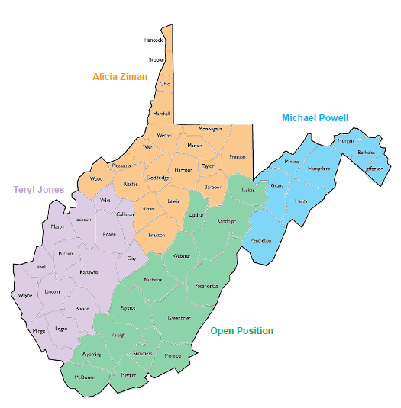

Slide 12
Face to Face
Mental Health First Aid
Behavior Intervention Plans and Functions of Behavior
Crisis Prevention Intervention (Partnering with Counties)
Challenging Behaviors/Classroom Management
Tier 2
Trauma

Slide 13
Book Study/ Professional Learning Communities Extension Activities
Help For Billy
Fostering Resilient Learners

Slide 14
Webinars
School-wide PBIS; The Why and How
Using Your Data the Right Way
Running Effective Meetings
Sustainability
Introduction to ECPBIS
Tier 2 Readiness

Slide 15
Other
Skype Meetings
Conference Call/Brief Call
Email
Provide Resources
Sounding Board

Slide 16
Next Steps
Expansion of the TA Center
Formal Request Process
Website

Slide 17
Upcoming Events and Projects
3rd Annual WV PBIS Conference
SWPBIS and ECPBIS Fall Academies
Introduction of Tier 2 Trainings
Introduction of FBA/BIP training and Online Learning Community
WV Tier 1 Model Schools

Slide 18
ECPBIS

Slide 19
What is ECPBIS, or, The Pyramid Model?
Early Childhood Positive Behavioral Interventions and Supports
aka The Pyramid Model

Slide 20
Let’s Reframe Our Knowledge:
Positive Behavioral Interventions and Supports are the practices that you put into place to get the positive behavior that you want from your students.

Slide 21
Purpose of ECPBIS…
Promote social and emotional development in all children including those with special needs

Slide 22
Let’s Think of Behavior as a Core Subject
If you want something you must teach it…and then you must acknowledge it.

Slide 23
Why ECPBIS?

Slide 24
ECPBIS
ECPBIS is classroom based. It relies on the teacher and the aide to implement.
ECPBIS is a toolbox of strategies and best practices for the teachers.
This toolbox allows you to build the educational foundation for your students and school.
ECPBIS becomes a way of life.

Slide 25
Goal of the Pyramid Model To Promote Children’s Success By:
Creating an environment where EVERY child feels good about coming to school
Designing an environment that PROMOTES child engagement
Focusing on teaching children what TO DO
1.)Teach expectations and routines
2.)Teach skills that children can use in place of challenging behaviors
Teach social and emotional skills
Support children with delays and disabilities in inclusionary settings
PREVENT challenging behavior
Continuum of Supports and Services = Promotion (all), Prevention (some), Intervention (few)

Slide 26
“If a child doesn’t know how to read, we teach.
If a child doesn’t know how to swim, we teach.
If a child doesn’t know how to multiply, we teach.
If a child doesn’t know how to drive, we teach.
If a child doesn’t know how to behave, we............teach? ......punish?
Why can’t we finish the last sentence as automatically as we do the others?”
Tom Herner (NASDE President ) Counterpoint 1998, p.2)

Slide 27
Basic Assumptions
Challenging behavior usually has a message- I am bored, I am sad, you hurt my feelings, I need some attention
Children often use challenging behavior when they don’t have the social or communication skills they need to engage in more appropriate interactions
Behavior that persists over time is usually working for the child
We need to focus on teaching children what to do in place of the challenging behavior

Slide 28
THE PYRAMID MODEL (center on the social and emotional foundations for early learning & Technical Assistance center on social emotional interventions for young children)

Slide 29
Effective workforce
The systems and policies needed to adopt and sustain the implementation of the Pyramid Model with a particular focus on supporting the social development and relationships of young children.
Systems
Policies
Focused on all children: including those with or at risk for delays or disabilities

Slide 30
Tier 1 Universal or Primary prevention
1.) Nurturing and Responsive Relationships
2.) High Quality Supportive Environments

Slide 31
ECPBIS Tier One – Leveling the Ground
Environment
“If you want it, you must teach it.”
Consistency. “ Leave no doubt.”
Relationships (ex. My 3 year olds)
Social Skills (books, songs, role playing)
Emotions
Mantras
Notes:
Kids don’t come to school magically knowing what to do.
Take the guessing out of it. Procedures, Schedule, how school works Teach and reteach until they know exactly what to do in almost any situation. With or Without you. One of the biggest compliments ever….Louis at the height of the behavior arc. Throwing chairs. Lisa came in and I apologized about the others.
The more you are consistent the more flexible you can be.

Slide 32
Nurturing and Responsive Relationships
Building block of the pyramid
Essential to healthy social development
Includes relationships with children, families, and team members
-actively supporting engagement
-embedding instruction within children’s routines and play
-responding to children’s conversations
-promoting communication
-providing encouragement to promote learning
Children learn and develop in the context of relationships that are responsive, consistent, and nurturing

Slide 33
High Quality Supportive Environments “Promote social and emotional development”
CLASSROOM and HOME ENVIRONMENTS
Design of a classroom and home
Predictable
Supportive
Fosters all areas of child development
Promotes skill development for children with delays and disabilities
Safe
Promote active learning
Promote appropriate behavior
Provide positive guidance for expectations or rules
Maximize engagement and learning

Slide 34
TIER 2 Secondary prevention
Targeted Social Emotional Supports
Explicit instruction and support
Self-regulation, expressing and understanding emotions, developing social relationships

Slide 35
Key Social Emotional Skills
Confidence
Identify emotions in others
Capacity to develop good relationships with peers and adults
Concentration and persistence on challenging tasks
Ability to effectively communicate emotions
Ability to listen to instructions and be attentive
Ability to solve social problems

Slide 36
Tier 3 Tertiary Intervention
Individualized Intensive Interventions
Family-centered, comprehensive interventions
Assessment based
Individualized Behavior Support Plan
Skill building

Slide 37
ECPBIS – Tier 2 and Tier 3
Build and continue to provide all the Tier 1strategies…it shouldn’t be a problem…it’s your infrastructure.
Challenging behaviors need more support:
An even stronger relationship
Communication with their families
Social Stories
More personalized and frequent incentives
Flexibility to make the adjustments that they need.
SAT, FBA, BIP

Slide 38
The key to managing the difficult behaviors of young children is to shift our thinking to manage our own behaviors and responses to behaviors.
–Dr. Rosemarie Allen
Dr. Amy Carlson

Slide 39
Looking at our Own Behavior
Avoiding Power Struggles ------- “Don’t pick up the rope.”
Rationale Detachment
Not all behavior is a “personal challenge”
Solution Focused
It’s not an event, it’s a process

Slide 40
It Starts with Us
It’s Us that…
When it may be…
labels the behavior as manipulative or defiant.
labels self-stimulation behavior as disruptive, odd, or distracting.
labels a student as unmotivated or apathetic.
a student trying to create some control in a life of chaos.
a student who is trying to regulate stress.
a student who is raising him/herself and/or his/her siblings.
Fostering Resilient Learner’s
Notes:
So in order to focus on solutions that will benefit the child and have more of a lasting impact we need to change the way we view and talk about behavior.

Slide 41
Major Messages
Children’s challenging behavior can be reduced with support not punishment
Promoting social emotional development is not easy. There are no quick fixes to challenging behavior.
Focus on prevention and teaching appropriate skills. If you want it, TEACH it!
The Pyramid Model *Key Feature* = The balance between acknowledgment and correction

Slide 42
A Note on School Wide PBIS

Slide 43
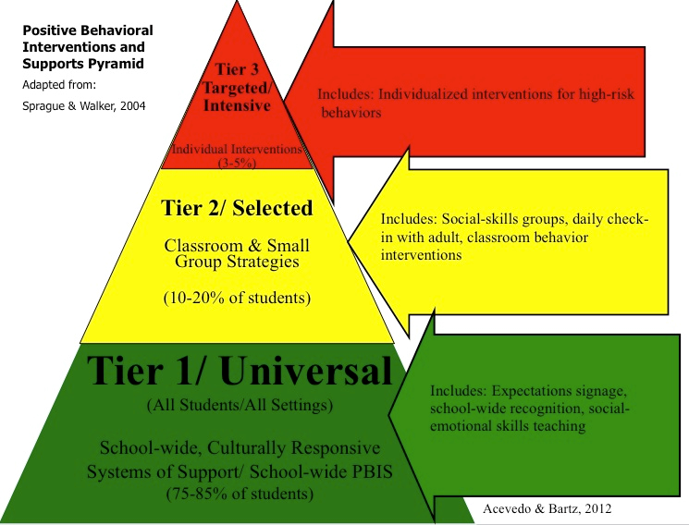

Slide 44
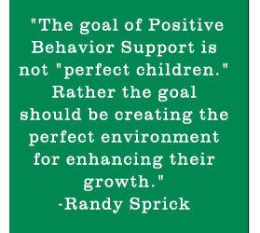

Slide 45
Tier 1 Core Features – What Do You Get From Tier 1
Leadership Team
School wide expectations
System to Acknowledge Behavior
Consequences for Problem Behavior
Classroom Systems
Data and Decision System
Bully Prevention
Family Collaboration

Slide 46
Tier 2 Core Features – What Do You Get From Tier 2 and 3?
Tier 2 and 3 Leadership Teams
Increased Structure
Additional Instruction on Behavior
Increased Level of Feedback
Increased Intensity of Data Collection
Increased Family Engagement

Slide 47
Why Does This Matter to You?

Slide 48
Our Worlds are Inextricably Intertwined
Engagement
Social/Emotional Development
Academic vs. Behavior

Slide 49
Learning happens best when…
Relationships are put first.
Environments are nurturing, consistent, and responsive.
Social Skills teach how to interact with each other and how to interact while learning.
ECPBIS provides these in classrooms!

Slide 50
Specific ELS Examples
PBIS | ELS Alignment
Supporting children’s play | Play is how children learn
Teaching communication (especially about emotions) | Expressive and Receptive language skills
Social skills | Approaches to Learning – responding/interacting to social interactions and learning
Supporting engagement | All Learning

Slide 51
Literacy Rich Framework
Visual Schedules
Choice Boards
Emotional Learning
(Books, Lessons, Games)
Social Stories

Slide 52
Turning “Can nots” into “Cans”
Kids Can’t Learn When They Are Not Regulated
Relationships Help
ECPBIS Provides a Framework to help regulation
Kids Can’t Learn When The Don’t Have “Instructional Skills”
Kids do not come to school knowing how to go to school
These can be taught!
Kids Can’t Learn When Our Teachers Don’t Know How to Handle Situations
Effective Workforce
Foundational Behavior Knowledge

Slide 53
What Do New Teachers Need to Know?
A Basic Understanding of Behavior (brain biology, function, an trauma)
Social Emotional Learning
Behavior is Everyones Issue

Slide 54
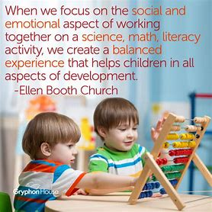

Slide 55
Questions… Answers…discussion

Slide 56
Thank You!
Amy Kelly M.A.
Director of TA Center
304.696.3514
kelly9@marshall.edu
Alicia Ziman
Regional Behavior Support Specialist – North
304.641.0473
holt64@marshall.edu

Slide 57
References
Fox, Lise (2016). University of South Florida
CSEFEL http:.//csefel.vanderbilt.edu
TACSEI http://challengingbehavior.fmhi.usf.edu
Pyramid Model Consortium www.pyramidmodel.org
Carter, R.C., Van Norman, R.K., & Tredwell, C. (2010). Program-wide positive behavior support in preschool: Lessons for getting started. Journal of Early Childhood Education, 38: 349-355.
Fox, L., Dunlap, G., Hemmeter, M.L., Joseph, G.E., & Strain, P.S. (2003). The teaching pyramid: A model for supporting social competence and preventing challenging behavior in young children. Young Children, July 2003, 48-52.
Little, M. (1999). Prevention and early intervention with children in need: Definitions, principles and examples of good practice. Children & Society, 13(4), 304-316.
Walker, H. M., Kavanagh, K., Stiller, B., Golly, A., Severson, H. H., & Feil, E. G. (1998). First Step to Success: An Early Intervention Approach for Preventing School Anti-social Behavior. Journal of Emotional and Behavioral Disorders, 6(2), 66-80.

