Slide 1

Text Sets:
Building Knowledge and Vocabulary
Notes:
Christy

Slide 2

Five Essential Studies
Hernandez 2011, “Double Jeopardy”
Lesnick et al 2010, “Reading on Grade Level in Third Grade: How Is it Related to High School Performance and College Enrollment?”
Fletcher and Lyon 1998, 74% of 3rd graders who read poorly will still be struggling in 9th grade.
Snow et al 1998, “A person who is not at least a modestly skilled reader by the end of third grade is quite unlikely to graduate from high school.”
Juel 1988, 1st grade reading scores are a “reliable predictor of later reading scores.”
Notes:
Tracy
Hernandez 2011 from the Annie E. Casey Foundation showed that students that are not reading proficient by third grade are 4 times less likely to graduate from high school on time than students who are reading proficiently in 3rd grade.
These 5 studies all suggest that if you are not reading successfully by at least the third grade your chances of catching up are low. This is both distressing and puzzling. Why would scores so early be such a strong predictor of outcomes later?

Slide 3
Why?
How is it that tests so early can predict results so many years later?
What are we doing in schools that might be perpetuating these trends?
What are we not doing in schools that might be perpetuating these trends?
Why does the gap between struggling and proficient readers increase the longer they are in school?
Notes:
Tracy
Chart ideas and share out – ideas and brainstorming
Give participants time to think on their own about each of these questions and to discuss or share out. In particular emphasis to them the point implied by the 4th question: the gap grows the longer students are in school.

Slide 4
What are not the causes?
Lack of critical thinking
Failure to know or use comprehension strategies
Failure to master the standards
Notes:
Tracy
Today our task is to challenge these “Typical” or Go-To answers.
This slide can use more or less explanation based on the audience. Tell them that we are going to look at some research and illustrations to explore this question more thoroughly, but that it’s worth starting with some common sense.
Lack of critical thinking is not likely to be the issue for at least two reasons:
Third grade reading tests don’t do a terribly good job of testing critical thinking. Mostly they seem to be tests of simple recall or comprehension, yet they are still predicting a wide variety of future outcomes.
Students seem to be able to think critically about a wide variety of topics that interest them. They routinely make inferences, analyze, draw connections and synthesize when talking about their sports, their arts, their social lives. For example, how quickly are students able to infer your moods or predict your behavior based on subtle clues from just a look on your face. But as soon as you put a piece of paper with text in front of them they seem to suddenly lose their ability to think critically.
Failure to know or use comprehension strategies also doesn’t seem like the likely cause.
Comprehension strategies are a lot like critical thinking i.e. making inferences, asking questions, predicting. Again students seem to do these things a lot, just not about material in print.
We have spent at least a decade or more heavily focusing our instruction on comprehension strategies. In fact it’s one of the dominant focus points of American educational practice across the country. And yet it seems not to have had much impact on this problem at all. If comprehension strategies were the problem, our efforts would likely have improved the problem, but so far they haven’t, as evidenced by studies a decade or more apart showing very similar results.
Failure to master the standards is probably not the issue either.
Once again the standards are similar to comprehension strategies are similar to critical thinking.
Moreover, much of this research occurred before most states even had standards. In addition standards have varied widely across states, but these results are remarkably consistent across geography. The advent of nationwide standards-based reform in the 90’s to the 2000’s didn’t seem to change this relationship.
Quick turn and talk

Slide 5
Quick Quiz:
WHICH IS HARDER?
Notes:
Tracy
Direct participants to pg. 1 of PARTICIPANTS HANDOUT
So if none of those factors are the cause, what is? The next activity will help us start to get at the answer.
This is a simple quiz. I’m going to show you two questions, and I want you to tell me, which question is harder.

Slide 6
Question 1: Literal Meaning
Low on Bloom’s Taxonomy
Restate the following sentence in your own words:
Notes:
Tracy
Read slide.
Emphasize that restating or paraphrasing is a very low-level skill that doesn’t require much critical thinking.

Slide 7
“The former render possible theoretical cognition according to principles a priori; the latter in respect of this theoretical cognition only supplies in itself a negative principle (that of mere contrast), but on the other hand it furnishes fundamental propositions which extend the sphere of the determination of the will and are therefore called practical.”
Notes:
Tracy
Read slide.
[Passage taken from pg. 1 of Immanuel Kant’s Critique of Judgment.]

Slide 8
Question 2: Synthesis
High on Bloom’s Taxonomy
Read the following passage, then write a letter to the editor defending the moral values the main character displays with regard to animals.
Notes:
Tracy
Read slide.
Emphasize that this task asks students to do a wide range of critical thinking including, inferring a character’s attitude based on their behavior, generalizing that to a set of moral values, then predicting what such a character might say in defense of those values, thinking about the audience of newspaper editor, and composing a piece of writing that presents an argument. Seems very difficult.

Slide 9
“Where's Papa going with that ax?" said Fern to her mother as they were setting the table for breakfast.
"Out to the hog house," replied Mrs. Arable. "Some pigs were born last night.“
"I don't see why he needs an ax," continued Fern, who was only eight.
Notes:
Tracy
Read slide
[Passage taken from page 1 of Charlotte’s Web, by E.B. White.]

Slide 10
"Well," said her mother, "one of the pigs is a runt. It's very small and weak, and it will never amount to anything. So your father has decided to do away with it.”
"Do away with it?" shrieked Fern. "You mean kill it? Just because it's smaller than the others?"
Notes:
Tracy
Read slide

Slide 11
Which question was easier?
Why?
Would a lesson (or a whole week of lessons) on “finding main idea” or “making inferences” help you to answer question 1?
Notes:
Tracy
At this point feel free to reveal the source of both passages to the audience (many will recognize Charlotte’s Web). Point out that the passages were from PAGE 1, that is this is where we are constructing a mental model of the situation that will help us make sense of everything that’s to come. If we are lost after page 1, it starts to feel hopeless going forward.
Ask the questions on the slide and give time for discussion and/or share out. Everyone should recognize that the first question was much harder and that this had something to do with the text, not just the questions being asked. Some may already be hypothesizing that vocabulary or knowledge have a lot to do with why we couldn’t answer the first question. You don’t need to confirm or point this out to them yet. It becomes clear soon.

Slide 12
What are not the causes?
Lack of critical thinking
Failure to know or use comprehension strategies
Failure to master the standards
Notes:
Tracy
Today our task is to challenge these “Typical” or Go-To answers.
This slide can use more or less explanation based on the audience. Tell them that we are going to look at some research and illustrations to explore this question more thoroughly, but that it’s worth starting with some common sense.
Lack of critical thinking is not likely to be the issue for at least two reasons:
Third grade reading tests don’t do a terribly good job of testing critical thinking. Mostly they seem to be tests of simple recall or comprehension, yet they are still predicting a wide variety of future outcomes.
Students seem to be able to think critically about a wide variety of topics that interest them. They routinely make inferences, analyze, draw connections and synthesize when talking about their sports, their arts, their social lives. For example, how quickly are students able to infer your moods or predict your behavior based on subtle clues from just a look on your face. But as soon as you put a piece of paper with text in front of them they seem to suddenly lose their ability to think critically.
Failure to know or use comprehension strategies also doesn’t seem like the likely cause.
Comprehension strategies are a lot like critical thinking i.e. making inferences, asking questions, predicting. Again students seem to do these things a lot, just not about material in print.
We have spent at least a decade or more heavily focusing our instruction on comprehension strategies. In fact it’s one of the dominant focus points of American educational practice across the country. And yet it seems not to have had much impact on this problem at all. If comprehension strategies were the problem, our efforts would likely have improved the problem, but so far they haven’t, as evidenced by studies a decade or more apart showing very similar results.
Failure to master the standards is probably not the issue either.
Once again the standards are similar to comprehension strategies are similar to critical thinking.
Moreover, much of this research occurred before most states even had standards. In addition standards have varied widely across states, but these results are remarkably consistent across geography. The advent of nationwide standards-based reform in the 90’s to the 2000’s didn’t seem to change this relationship.
Quick turn and talk

Slide 13
Everyone knows knowledge plays a role in comprehension, but how big of a role?
Notes:
Tracy
No one disputes that prior knowledge is important to comprehension, but when students struggle with comprehension, we rarely focus on building knowledge as our primary intervention. Instead we practice comprehension strategies, attempt to build stamina, or simply ask kids to practice.
When many things seems important, knowing how big the impact of each factor is, helps us to choose an area to focus on.

Slide 14
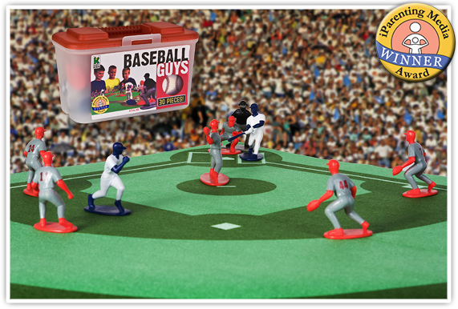
“The Baseball Study,”
Recht & Leslie (1988)
Notes:
Christy
Recht and Leslie sought to answer exactly this question, by comparing the relative impact of reading ability to the impact of knowledge of a topic. They had students read a passage about baseball and then tested students comprehension of the passage.
“Effect of Prior Knowledge on Good and Poor Readers‘ Memory of Text” from Journal of Educational Psychology 1988, Vol. SO, No. 1, 16-20
Had 7th and 8th grade students read a short text about baseball and tested them for comprehension using:
Verbal retelling
Reenactment with figurines
Verbal summary
Rating ideas from the story in terms of importance.

Slide 15
“The Baseball Study,”
Recht & Leslie (1988)
Compared reading comprehension for four categories of students:
High reading ability High knowledge of baseball | High reading ability Low knowledge of baseball
Low reading ability High knowledge of baseball | Low reading ability Low knowledge of baseball
Notes:
Christy
Quick check for understanding/following along. Ask people who they think was in each category (i.e. likely “jocks” in the low reading ability, high baseball knowledge group; “nerds” in the high ability low knowledge of baseball group).
The students in these 4 groups read a passage about baseball and then took a test of their comprehension. Ask participants to predict what % of questions on a reading comprehension test each category of student would get right. The best is for them to draw a grid on their paper and put an actual % of predicted questions correct in each quadrant. Tell them that the colors are so they can quickly match the group with the graphs on the next slide.
Technical Notes:
“The high-ability /high-knowledge cell had 10 boys and 6 girls; the high ability/low-knowledge cell had 3 boys and 13 girls; the low-ability/
high-knowledge cell had 12 boys and 4 girls; and the low-ability/low knowledge cell had 7 boys and 9 girls.”
High reading ability was defined as 70th percentile or higher on a standardized test of reading. Low reading ability was defined as 30th percentile or lower.
High knowledge of baseball was defined as 70th percentile or higher on a test of baseball knowledge. Low baseball ability was defined as 30th percentile or lower.

Slide 16
Notes:
Christy
After they predict percentages, show them this slide and give them a minute to take it in. They should notice that the low reading ability students with high knowledge (the “jocks”) outperformed the high reading ability students with low knowledge (the “nerds”). In addition there is little difference between the two high knowledge groups and the two low knowledge groups.
from pg. 18, table 1, Recht & Leslie 1988. (Qualitative Measure) Note: conversion from raw numbers to percentages achieved by dividing score by achieved by total possible score.
Frequently Asked Questions:
Is this study generalizable? Yes! In fact a European study replicated the finding exactly with students of a totally different background on the topic of soccer. Additional research has shown similar results on a wide variety of other topic and subject areas.
Is the impact here from knowledge or from interest? Knowledge. It’s hard to disentangle these variables, but a separate study using basketball was able to distinguish the two and found that the one that had the major impact was knowledge.
If knowledge is so important does this undermine the value of close reading? No. Close reading teaches students how to gain knowledge from text by attending to it carefully. But, as we will soon discuss, high volume reading of informational text is also necessary to build the base of knowledge and vocabulary necessary to succeed with close reading. This is a BOTH, AND type of question, not an either or.

Slide 17
Findings
Knowledge of the topic had a MUCH bigger impact on comprehension than generalized reading ability did. (pg. 18)
With sufficient prior knowledge, “low ability” students performed similarly to higher ability students. (pg. 19) The difference in their performance was not statistically significant.
Notes:
Christy
The second bullet point here has a big implication for student scaffolds. By helping students build their knowledge, “low readers” can perform at levels similar to “high readers.”
Reference:
“With adequate prior knowledge, those students who are comprehending below the 30th percentile on the SRA [standardize reading assessment] are comparable with those above the 30th percentile in reenactment, verbal recall, and the ability to summarize text.” (pg. 19)

Slide 18
A student doesn’t have ONE level.
Each student has MANY LEVELS depending on topic & knowledge.
Notes:
Christy
This research is in direct opposition to current instructional practice where we identify a reader by an F & P level, and if you are a level J then you read only level J books. But a level J reader on science passages may be a level T reader on explorers, if they have knowledge of that topic. By letting them read only level J texts we deny them access to more complex text that they could access and learn from on a topic on which they have knowledge.

Slide 19
Vocabulary
Research has shown that when it comes to risk factors for vocabulary development, poverty trumps race, urban vs. rural community, limited English proficiency, and language impairments.
Vocabulary interventions have to be powerful enough to accelerate, not just incrementally advance word learning for students coming from low-income households to narrow the achievement gap.
(Marulis and Neuman, 2011)
Notes:
Christy

Slide 20
Vocabulary
By the time they reach school age, low-income children have heard fewer words than higher-income children.
30,000,000
fewer
Notes:
Christy

Slide 21
Imagine what it’s like to be a student with vocabulary and knowledge deficits…
…on test day.
Notes:
Christy
What comes next is a way of making the point vivid and memorable, and emphasizing not just the instructional value, but the moral urgency of helping kids develop the word and world knowledge they need. If we don’t help them rapidly gain vocab and knowledge, this is what they face every time they open a book or newspaper.

Slide 22
Ready to give up, yet?
Notes:
Christy
Read some of this aloud filling in the blanks with the word “something.” It’s not necessary to do it as a full exercise, or to read through every slide. Just enough to get the point across. How Did That Feel?

Slide 23
When she was twenty-six, Eliza bought tickets to faraway Alaska. Few tourists had ever been there. Eliza wrote reports for the newspapers back home. She loved sharing the fascinating things she saw, such as huge glaciers, spouting whales, and the native people. Eliza even wrote a book – the first guidebook about Alaska.
When Eliza went back to Washington, it wasn’t long before she started thinking about traveling again. She decided to visit her older brother, who was working in Japan. Eliza sailed across the ocean.
Notes:
Christy

Slide 24
We owe our students a better experience reading than this.
We have to help them get the vocabulary and knowledge of the world they need to be able to read complex text.
Notes:
Christy
At this point take some time for them to discuss how seeing the passage like this connects to the reading comprehension questions provided with the passage. Let them discuss and really drive the point home about what kids need (reading strategies? or knowledge and vocab?), you can ask teachers to imagine being asked the questions about the passage they just read.
Specific details - What was one problem that Eliza experienced? Find evidence in the text to support your answer.
Inferences - What can you infer about the relationship between Japan and America from the response of the Japanese government to President Taft’s actions?
Main idea – How did Eliza eventually achieve her dream?
Does failure to answer these questions correctly mean that you don’t have mastery of the SKILLS required by the questions?
Why or why not?
What would you most need to answer these questions?
Discuss and share out.

Slide 25
Students cannot build knowledge and vocabulary without a high volume of reading.
Most words are learned through reading or being read to.
Building knowledge helps level the playing field for students.
Notes:
Tracy -

Slide 26
Not all high-volume reading is equally effective
Research by Landauer and Dumais into vocabulary acquisition shows that students acquire vocabulary up to four times faster when they read a series of related texts.
Reading a number of texts within a topic grows knowledge and vocabulary far faster than any other approach.
Notes:
Christy
Contrast this to the typical way we do business where we skip around from topic to topic, plants today, tree mammal tomorrow, the colonies the day after. Instead we need to spend time reading several texts within the same topic in order to build knowledge and vocabulary faster. With the huge volume of words and huge bodies of knowledge that students need to learn, we can’t afford to not use the most effective, fastest way to gain this knowledge.
The research referenced here is what led to the creation of the idea of text sets: a thoughtfully sequenced series of texts designed to build knowledge and vocabulary.

Slide 27
Text Sets – Expert Packs
Collection of resources organized for students to build knowledge about a specific topic
Glossary of terms to help students access challenging vocabulary (repeated terms and concepts)
Suggested activities to help students capture and express their learning
Notes:
Christy
Many PreK classrooms are already reading around a topic. Especially if those classroom are using Project Based Learning.

Slide 28
Activities
Notes:
Tracy
Possible activities to use with Expert Packs-

Slide 29
Rolling Knowledge Journal
After you read each resource, stop and think what the big learning was.
What did you learn that was new and important about the topic from this resource? Read each selection in the set, one at a time.
Write, draw, or list what you learned from the text about (topic).
Then write, draw, or list how this new resource added to what you learned from the last resource(s).
Notes:
Tracy

Slide 30
Sample Student Response
Title | Write, Draw, or List
 | New and important learning about the topic | How does this resource add to what I learned already?
1. “For the World’s Poor, Drinking Water Can Kill” | lack of clean drinking water affects about 800 million people in the world
2. “Millions Lack Safe Water” | Lack of clean drinking water affects people in different places in different ways | The maps show all the different places the 800 million people affected live; and the facts describe the many ways people are affected by the lack of clean water
3. “The Water Cycle” | The water cycle | How the water cycle works on earth everyday
4. “Water, Water, Everywhere!” | The many sources of water on earth | Even though water is everywhere, not all water can be used as clean water
5. Hydrology: The Study of Water | This story provides basic information about the study of water | This book explains the science behind water and how water affects history and the future.
6. A Drop Around the World | Water gets used over and over on earth | This story gives a lot of examples and pictures of how the water cycle matters to everyone and everything on earth
7. “Researchers Discover Huge Underground Water Reserve in Africa” | There is water underground and researchers are trying to learn more about it. | Hydrologist can use their expertise to find out more about the underground water in Africa. It could help millions of people
8. “What is Your Water Footprint?” | how much water I use in my life | the website gave me ideas for how I can conserve water
Notes:
Example of Rolling Knowledge Journal
Whole Group – Spring or later in the year
Split into grade level groups 2-3 people and discuss ways to scaffold this activity for your students. Share out whole group. (10 minutes)

Slide 31
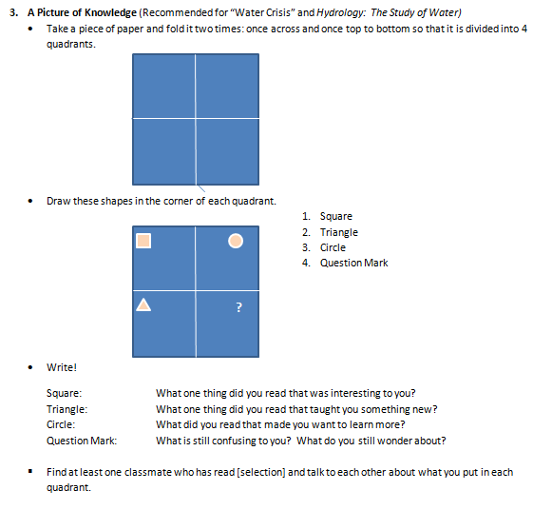
A Picture of Knowledge
Works well with resources that provide a lot of varied information
Resources that provide an overview of a topic
Resources that contain many facts and basic information
Notes:
Tracy
Read instructions from slide and discuss information in the text box. Try this activity using the chicken story and the back of their folded paper from earlier in the session.
What was your favorite part?
What did you learn?
What do you still want to know?
What do you Wonder?

Slide 32
Square: What one thing did you read that was interesting to you?
Triangle: What one thing did you read that taught you something new?
Circle: What did you read that made you want to learn more?
Question Mark: What is still confusing to you? What do you still wonder about?

Slide 33
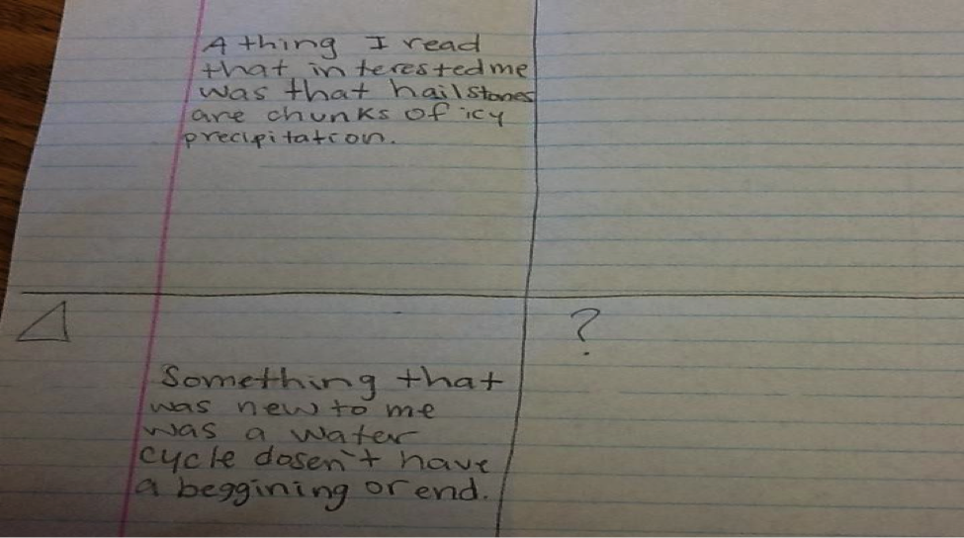
Sample work
Notes:
Big Idea: Students decide what learning to record. This is a great formative information about what they are focusing on, what meaning they are making, what confuses them.

Slide 34
Text Set Project
Notes:
Tracy

Slide 35

WV Library Commission
Text Set Lending Library - Request Form
Notes:
Tracy

Slide 36

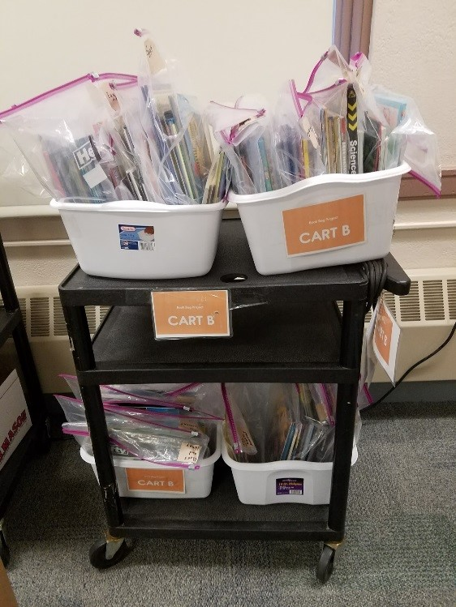
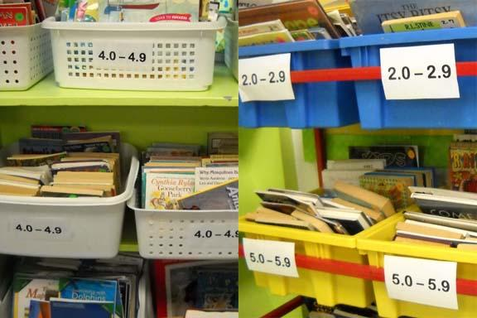
Book Baskets, Libraries, and Book Bags
Notes:
Tracy - There are many ways in which classroom teachers and school librarians make decisions about how to display and organize texts for independent reading in the classroom. Organizing book baskets, selecting texts to go in student book baggies, and/or setting up shelves in school and classroom libraries are just a few of the many options under consideration.
Note: If your school or district had a required system that you are changing you may want to reference this now

Slide 37

Time to change the libraries!
Instead of levels-- try TOPICS!
Let’s see what happens to students’ reading engagement, enthusiasm, and motivation when they select books based on what they want to read about, rather than their level!
Notes:
Tracy - That brings us to the goal of this work.

Slide 38
Text Sets
Book Baskets
Library of informational texts organized by topic
Each basket is organized from least complex to most complex
Companion Text Sets
Set of related texts that go along with an existing close reading lesson to build additional knowledge about the topic
Include short culminating writing tasks
Expert Packs
Build knowledge to create “experts” on an informational topic
Include an annotated bibliography and text complexity that gradually increases
Offer activities that can be structured in a variety of ways
Research Packs
Build knowledge in preparation for writing about a Next Gen. science topic
Include writing component with scaffolds for teachers and students
Encourage a gradual release of responsibility with whole group, small group, and individual activities
Notes:
Tracy

Slide 39
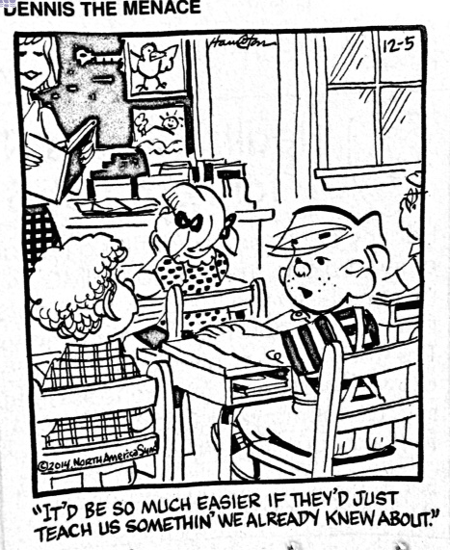
Notes:
Tracy
Big Idea: We all can relate to this!
Details:
Though this is just a comic, this is the idea behind text sets. To take what students already know something about and build on it.

Slide 40



Christy Schwartz
cschwartz@k12.wv.us
Tracy Komorowski
tbkomorowski@k12.wv.us
Notes:
Tracy

