Slide 1
Small Group Instruction
Notes:
Christy 2 min.

Slide 2
Session Goals
By the end of this session, participants will be able to:
Identify the prerequisites for successful implementation of small group instruction
Effectively use assessments and grouping for both foundational skills and comprehension instruction
Successfully implement both teacher-led and student-led groups

Slide 3
Small Group Instruction
Allows for targeted, needs-based (data driven) instruction in two key areas:
Supported student practice – student-led work stations
Direct Teacher Support – teacher-led instructional groups

Slide 4
Student-Led Work Stations
Should include:
Multiple opportunities to practice the targeted foundational skills for the week
Opportunities to practice skills that were not previously mastered

Slide 5
Student-Led Work Stations
Should be:
Connected to current learning with a clear and relevant goal
High quality
Engaging
Independent
It is far better to have fewer groups with strong and relevant tasks than lots of groups doing varied activities that range in quality and focus.
Adapted from Student Achievement Partners Foundational Skills Guidance Documents
Notes:
This instructional time is effective when students are engaged in high-quality tasks that directly reinforce what they have been taught. Students do not benefit from low-level practice or tasks that aren’t connected to current learning. Running groups and centers simultaneously takes significant management from the teacher. It is far better to have fewer groups with strong and relevant tasks than lots of groups doing varied activities that range in quality and focus. - Student Achievement Partners Foundational Skills Guidance Documents

Slide 6
Prerequisites for Success
Notes:
Christy – 2 min;

Slide 7
Preparing for Small-Group Instruction
Environment
Flow of Movement
Classroom Management
Routines and procedures
Differentiation
Data-driven
Materials
Supports learning goals
Behavior
Flexible grouping
Aligned to learning goals
Gradual release of responsibility
Notes:
This is both a continuum and a cycle in that if there is a breakdown, you may need to revisit one of the previous areas.

Slide 8
Common Barriers to Small Group Success
Wrong-Fit Tasks – too easy or too hard
Too Much, Too Soon – not enough practice with routines and procedures
Changing Activities Too Often – try to change the content more often than the structure
Not Aligned with Learning Goals

Slide 9
Create a plan for implementation
Consider using a structured routine for phasing in work stations
14-Day Planner for Phasing in Small Group Instruction and Literacy Work Stations (Grades 1-5)
21-Day Planner for Phasing in Small Group Instruction and Literacy Work Stations for Kindergarten
Notes:
Go into planners and show admins what they are and explain how teachers might use them. Explain that the 21-day planner might be useful for other grades if more explicit instruction and practice with procedures are needed – a class that has a high number of students who need extra support with behavior, for example.

Slide 10
Effective Grouping
Notes:
Becky 4 min. Grouping is the heart of small group instruction. Knowing how and why to group students for different lessons is vital. Not every lesson has the same learning target or ending goal, therefore student should be group in a variety of ways. First, lets talk about how to group students.

Slide 11
Standardized Reading Tests are Single Factor Tests
“Standardized comprehension tests do not measure multiple skills; they measure…reading comprehension.”
Notes:
“How and How not to Prepare Students for the New Tests” by Timothy Shanahan
The Reading Teacher, Volume 68, Issue 3, November 2014, Pages 184–188
Abstract: http://onlinelibrary.wiley.com/doi/10.1002/trtr.1315/full
Full text: http://marcishepard.org/website/SBAC%20website/Pr%20article%20How%20To%20Prepare%20Students%20for%20State%20Assessments.pdf
As a teacher I am guilty of using standardized testing to help form my intial groups for small group instruction. When I was a beginning teacher, there was so much pressure on benchmark scores that I was often guided by adminstrators and fellow teachers to use these for my small group instruction. The problem is standardized tests and benchmarks do not give you the whole picture of a child. They give you snapshot in a single moment in time. Additionally, the information obtained from these tests is not comprehensive.

Slide 12
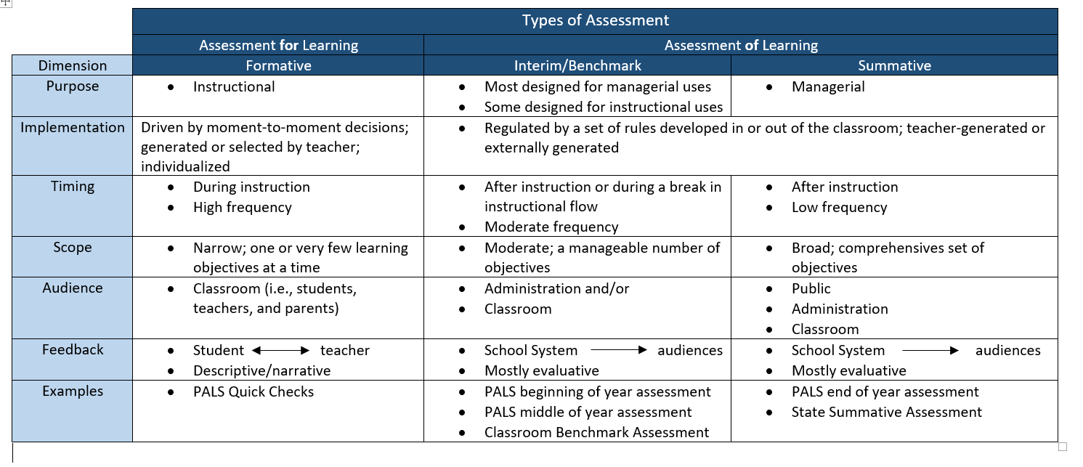
Types of Assessments
Notes:
As I began learning more about small group instruction and how to use it effectively, I began to steer clear of just using my benchmark for grouping. I began using other types of assessments. With so many different types of assessment, which ones are appropriate for helping guide instruction and group effectively?

Slide 13
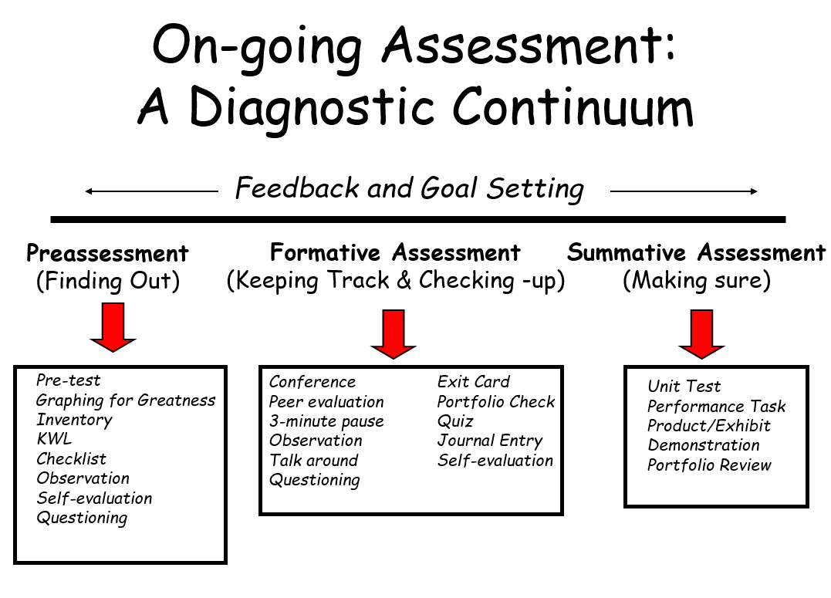
Appropriate Assessments for Grouping
Notes:
Formative assessment is a deliberate process used by teachers and students during instruction to adjust teaching and learning. It highlights the needs of each student and provides precise immediate feedback. It also helps to encourage students to assume greater responsibility for their learning because they are a part of the process. I wanted to share this visual of how formative assessment can be used to instruct small groups and a small sample of the variety of ways it can appear.

Slide 14
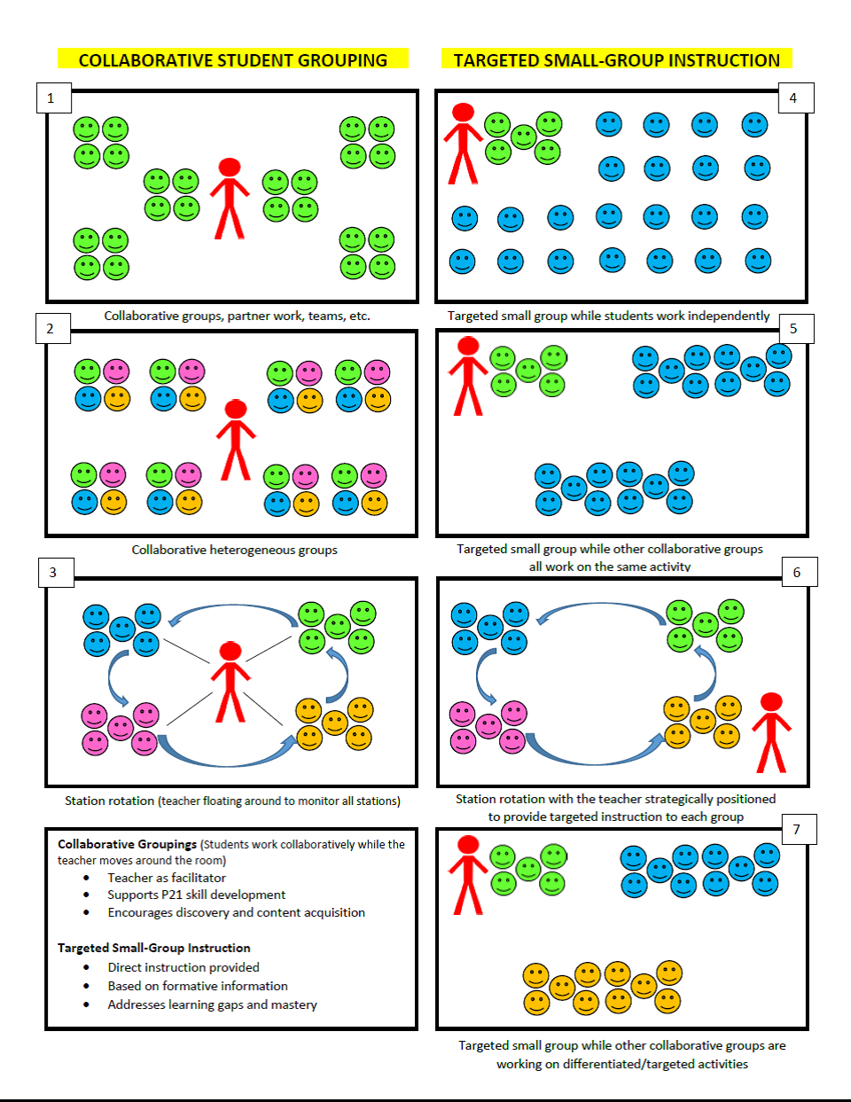
Small Group Models
Notes:
Small group models come in various shapes and sizes. Here are a just a few that I wanted to highlight.

Slide 15
Successful Implementation
Notes:
Becky 2 min.
How can you tell if you've set your class up for success when implementing groups?

Slide 16
Small Groups and Rigor
Set high-expectations
Provide choice and relevant assignments
Support students to learn at high levels
Differentiate the instruction not the content
Scaffolding
Provide opportunities for students to demonstrate high levels of learning
Notes:
Rigor is often thought of as more work or students quietly sitting working on things. However, that is not accurate. Rigor is “creating an environment in which each student is expected to learn at high levels, each student is supported so he or she can learn at high levels, and each student demonstrates learning at high levels” (Blackburn, 2013). In order to create this type of environment we need to being with setting high-expectations for all students. We need to also provide choices throughout the instruction where students can take ownership in their learning as well making sure the assignments that they are working on are relevant. If students feel that relevance in the lessons they are not going to put in the effort that is needed to produce a great product. Another way we create rigor in the classroom is through support all students to learn at high-levels. This means that we need to differentiate our instruction not the content and provide scaffolds for the students who need that extra support. We also instill rigor in the classroom when we provide opportunities for students to demonstrate high levels of learning.

Slide 17
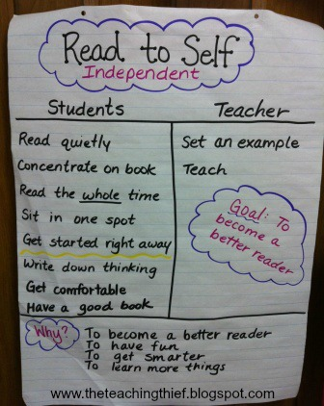
10 Steps to Teaching and Learning Independence
Identify what is to be taught
Set a purpose and create a sense of urgency
Record desired behaviors on I-chart
Model most-desirable behaviors
Model least-desirable behaviors, the most-desirable
Place students around the room
Notes:
It seems very simple but children just like adults can attend and focus better when they know exactly what they will learn. The first part involving your students in the implementation part is to begin with a visual (anchor chart) that students can refer back to. So creating an I-chart with your students for each station will help define exactly what they will be learning. The title of the I-chart is the what is to be taught. It is human nature to want to know the why behind something we have to do. “What’s in it for me?” Therefore we need to clearly articulate and post why we do things So to set a purpose and create a sense of urgency we record on the I-chart the reason why or as in the picture the “goal”. Next the teacher without conversing with students lists the desired behaviors for both the students and the teacher. Next we model those behaviors. This is a great opportunity to build confidence in struggling kiddos to shine by demonstrating the desired behavior. For step 5, the teacher should take the role of modeling the least-desired behaviors and then have students model the desired behaviors. After students have successful modeled desired behaviors it is time to practice. Have students choose their own spots for practice session.

Slide 18
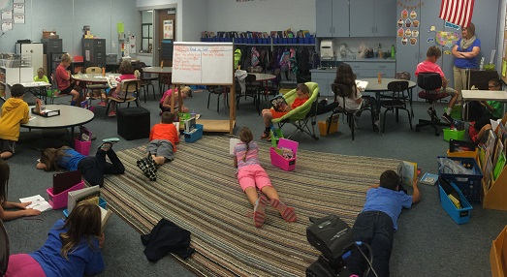
10 Steps to Teaching and Learning Independence
Practice and build stamina
Building capacity
Positive self-talk/self-regulation
Model persistence
Stay out of the way
Train for self-reliance rather than teacher dependence
Use a signal to bring them back
Conduct a group check-in
Notes:
When we talk about practicing and building stamina, are increasing our students capacity to focus on a given tasks. In the beginning to help our students build capacity as a class begin tracking the time that they can show the most-desired behaviors, then record time on a chart that is visible to everyone. This visual display of stamina grown will begin to help many students make sense of the concept of stamina. Teaching strategies for positive self-talk empowers our students to gain confidence, exceed expectation, and flourish in the classroom. This in turn will help them when they encounter challenging work by creating ways that they can boost their confidence and refocus their thoughts about what they are doing instead of only thinking about the negative aspects and giving up. By modeling persistence, we are actively showing our students those self-talk techniques in action and letting them know that it is ok to dig deep and not give up. We reinforce that idea that learning is the process of making mistakes and gaining insight from those mistakes in order to adjust what we are currently doing in order to make improvements. One of the hardest things for teachers is to stand back and not wonder or move about the room. So as students are involved in the building stamina the best thing teachers can do is to stay quietly in one spot, not moving. This stillness removes external stimulus for children and allows to focus on practicing. When teachers notice that a child has exhausted their stamina, teacher use a quiet signal (such as soft voice, a chime, etc…) to signal to all students that is it time to meet as a group. This is the power of calm that remove the trigger of escalation of noise as students put away materials and move to a common meeting place that was previously established. Which leads to step 10 conducting a group check-in to self-reflect on how each child felt they did during the activity. One way to go a group check-in is to have students rate themselves using their fingers as a scale on each individual expectation. Teachers can also ask students to rate how they felt they did for the whole lesson as well as getting started.

Slide 19
Addressing Foundational Skills vs. Comprehension
Notes:
Christy – 2 min.

Slide 20
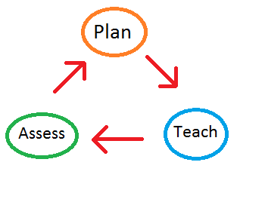
Traditional Literacy Instruction Oversimplifies Reading Comprehension
Could be...
But could also be...
Vocabulary
WVCCRS ELA.3.3
Describe characters in a literary story (e.g. their traits, motivations, or feelings) and explain how their actions contribute to the sequence of events.
Syntax
Density of information presented
Fluency
Stamina
Knowledge demands
...among other things.
From David Liben’s SAP Webinar, The Problem of Teaching Literacy Backwards
https://achievethecore.org/page/3176/the-problem-of-teaching-literacy-backwards-2018-july-webinar
Notes:
Question from released 3rd grade state assessment.

Slide 21
Using Isolated Comprehension Skills and Strategies in a Teach > Assess > Reteach Cycle...
“A smooth road in the wrong direction.”
-Silas Kulkarni, Teaching Lab
From David Liben’s SAP Webinar, The Problem of Teaching Literacy Backwards
https://achievethecore.org/page/3176/the-problem-of-teaching-literacy-backwards-2018-july-webinar
Notes:
Using a text-first approach is a rough road that may not be immediately apparent, but over time this method will become more and more clear.

Slide 22
Literacy Instruction Backwards
Traditional literacy instruction isolates, teaches, assesses and reteaches comprehension skills or standards.
Instead, we should use this method for foundational skills and let the text guide our reading comprehension instruction.
From David Liben’s SAP Webinar, The Problem of Teaching Literacy Backwards
https://achievethecore.org/page/3176/the-problem-of-teaching-literacy-backwards-2018-july-webinar

Slide 23
Resources
Notes:
Christy - 2 min.

Slide 24
Resources
OEEL March Listserv with BRD table
To be added to the monthly Listserv, please email Charlotte Webb at ctwebb@k12.wvus
Foundational Skills Resources from SAP
Small Group Resource Folders
WV Info Depot
To access any of the links that take you to Ebsco Host/Explora or Scholastic Go, the username is WEST and the password is VIRGINIA. To access World Book Online, the username is 4WEST and the password is VIRGINIA. If you choose the Advanced Search feature on Explora (Ebsco Host) Primary, Middle and HS, and Novel List Plus, you can specify the Lexile level(s) of the resources you request!

Slide 25
Reflections/Questions?

Slide 26
Contact Information
Rebecca Lewis
relewis@k12.wv.us
304-270-7299
Christy Schwartz
cschwartz@k12.wv.us
304-382-1373

Slide 27
A Return on Your Investment
Higher Ed Symposium

Slide 28
Purpose and Background
Dr. Paine’s Attendance Task Force
Legislative Session
Leadership Residency

Slide 29
Visible Learning, John Hattie (2009)
“Indeed, one of the fascinating discoveries throughout my research for [Visible Learning] is discovering that many of the most debated issues are the ones with the least effects. It is a powerful question to ask why such issues as class size (0.21), retention (that is, holding a student back a grade) (-0.32), school choice (0.12), summer school (0.23), and school uniforms (0.0) command such heated discussion and strong claims. Such cosmetic or “coat of paint” reforms are too common…
However, the most powerful effects of the school relate to features within schools, all of which allow student and teacher to make errors and develop reputations as learners, and which provide an invitation to learn.”

Slide 30
Invitational Education

Slide 31
Fundamentals of Invitational Education
Non-people centered approaches to school improvement simply don’t work.
This is a process that involves everyone: principal, teachers, bus drivers, custodians, secretaries, cafeteria workers, parent volunteers, and the community.
Whatever the intensity, it is important to remember that even the smallest inviting act is significant.

Slide 32
Rita Pierson: Every Kid Needs a Champion
We know why kids drop out, but one of the things that we rarely discuss is the value of human connection - relationships.
James Comer, (Professor of Child Psychology, Yale) states that no significant learning can occur without a significant relationship.
George Washington Carver says that all learning is understanding relationships.
Kids don’t learn from people they don’t like!
https://youtu.be/SFnMTHhKdkw

Slide 33
Linda Cliatt-Wayman: How to fix a broken school? Lead fearlessly, love hard
If you’re going to lead, lead.
So what. Now what?
If no one told you today that they love you, remember that I do, and I always will.
https://youtu.be/Xe2nlti47kA

Slide 34
Customer Service = Hospitality
The secret to the success for Chick-fil-a

Slide 35
Why do we do this
Hospitality is about ensuring the guests (children and families) feel cared for.
It is the opportunity to show honor, dignity, and respect to all of our guests (children and families), and have a positive impact on all who come in contact with our company (schools).
The concept and heart behind hospitality is simple
Executing it consistently can be very difficult
There must be service processes in place to be consistent
You must have the right people in the right places, saying and doing the right things

Slide 36
What does the research say?
Summer school .23
Class size .21
School choice .12
Charter schools .09
School uniforms 0.00
Retention (that is, holding a student back a grade) -0.32

Slide 37
What does the research say?
Teacher estimates of student achievement 1.62
Teacher credibility .90
Teacher-student relationships .52
Parent involvement .50
Teacher-student interactions .50

Slide 38
Take Aways
The only investment with a lasting return is the investment in people and relationships.
We are in the people business. Learning to cultivate relationships is as important, if not more important than gaining expertise in teaching strategies.
The smallest inviting act is significant. Do something.

Slide 39
Charlotte Webb
814-525-9662 (Mobile)
304-558-9994 (Office)
ctwebb@k12.wv.us

