Slide 1
Implementing Best Practices in Language and Literacy (PK–3) for Teacher Candidates Candidate-Teacher Paired Professional Development in Phonics Campaign Partner Grant Awareness of Adult-Child Language Interactions with LENA Shepherd University Center for Teaching and Learning (Mini-Grant)
WV Leaders of Literacy Symposium
April 25, 2019
Shepherd University
Terresa Kepner
LeAnn Johnson

Slide 2
Candidate-Teacher Paired Professional Development in Phonics Campaign Partner Grant

Slide 3
Standard Pre and In-Service Model
Candidates Take Class on Campus
Read Textbook and Other Materials for Class
Source Material for Classes
Phonics and Word Study for the Teacher of Reading: Programmed for Self-Instruction by Barbara J. Fox
Words Their Way: Word Study for Phonics, Vocabulary, and Spelling Instruction by Bear, Invernezzi, Templeton, and Johnston.
Phonics Chapter in Literacy for the 21st Century: A Balanced Approach by Gail Tompkins
In Class Discussion
In Class Small-Group Activities
Plan Three Phonics-Based Lessons
Read Aloud
Design and Introduce a Phonics Center
Guided Reading Lesson
Teachers attend County and/or School In-Service Training
Incorporate methods into daily plans.
Allow Candidates to do lessons with their kids for the university class.
Plan on Campus—Implement

Slide 4
Collaborative PD Model
Elementary Literacy Methods Classes
School Based PD of Literacy Methods
Teacher Candidates
Cooperating Teachers
Attend School-Approved PD Workshop
On Campus
Collaborative Planning To Implement
Co-Teaching
Collaborative Problem-Solving

Slide 5
Grant Results
Two fall workshops, two spring workshops with Katie Garner
All Elementary and Early Education Teacher Candidates in Literacy Methods Courses and their teachers trained by Katie Garner (N=100+).
Secret Stories Materials Provided for classrooms of all Participating Teachers
Secret Stories is continuing to be implemented by participating teachers.
New teachers trained to use phonics program being promoted in area schools.
University Faculty trained and given materials to continue to use in Literacy Methods Classes.
Same model was used this year with professional development school grant to train candidates and teachers in guided math with Nicki Newman.

Slide 6
Awareness of Adult-Child Language Interactions with LENA Shepherd University Center for Teaching and Learning (Mini-Grant)

Slide 7
MIT cognitive scientists have now found that conversation between an adult and a child appears to change the child’s brain, and that this back-and-forth conversation is actually more critical to language development than the word gap. In a study of children between the ages of 4 and 6, they found that differences in the number of “conversational turns” accounted for a large portion of the differences in brain physiology and language skills that they found among the children. This finding applied to children regardless of parental income or education.
(Trafton, 2018, ¶ 2)

Slide 8
What are our goals as educator preparation programs in early childhood education?
Engage students in metacognitive activities related to self-reflection and professional development
Heighten awareness of “teacher talk” with young children
Develop an understanding of how teachers scaffold language and literacy development in young children
Encourage the development of child-focused interactions in the classroom through effective conversations
Engage in research-based teaching and learning to support and implement best practices in the classroom setting

Slide 9
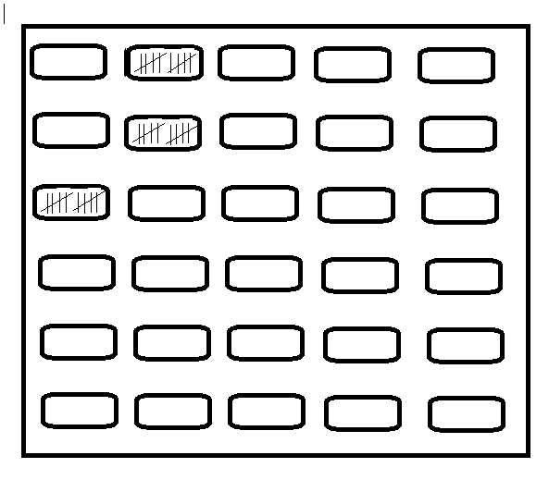
Teacher as Reflective Problem Solver (TARPS)
The TARPS model recognizes that to be a reflective problem solver, the prospective teacher must reflect on his / her Knowledge, Disposition, and Performance.
Example: ELA Questioning
Problem:
Accuracy of Perception in Self-Reflection

Slide 10
How do we improve accuracy in self-reflection?
Problem:
Accuracy of Perception in Self-Reflection
Audio and/or Video Recordings of Interactions with Children
Allows for better accuracy for analytical reflection than relying on candidates’ simple recall and memory of events.
NEW Problem: Level of Analysis -- General/Basic Reflections

Slide 11
Reflect on the Following Audio Recording
What do you hear?
Toni & “K”

Slide 12
Objective of Implementing LENA for Self-Reflection
LENA = Language ENvironment Analysis
The mission of the LENA Research Foundation “is to accelerate language development in children birth to three, in order to improve their cognitive, social, and emotional health and to close opportunity gaps” (LENA, 2019, ¶ 9).
By using the LENA technology – which includes the Digital Language Processor (DLP) and the LENA analysis software – our students are now able to analyze the quality of their conversations with young children as well as their overall oral language development.

Slide 13
The LENA Report

Slide 14
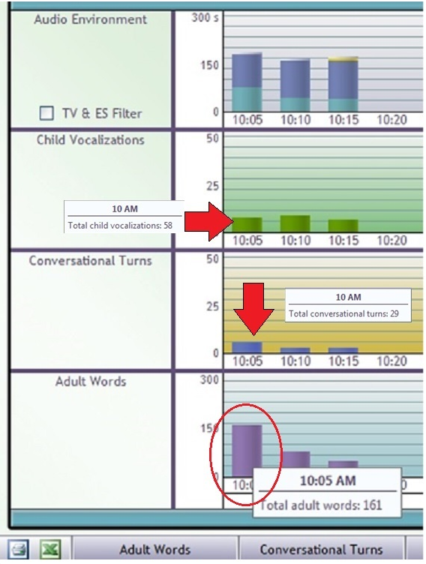

Slide 15
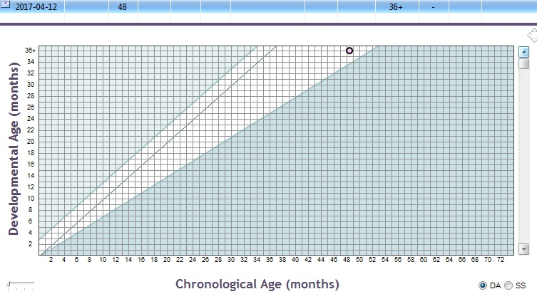

Slide 16
How do we use the data to help students self-reflect?

Slide 17
Example Responses from Students
“I talk too much…” [Here’s What]
“S/he’s talking, but only one-word responses.” [Here’s What]
“I’m not asking the right kind of questions. They’re probably not open-ended or don’t encourage the child to talk more.” [So What]
“I need to ask more open-ended, higher-level thinking questions.” [Now What]

Slide 18
Our Next Steps
Conduct two separate DLP / LENA recording sessions:
After first recording, have students reflect upon and complete “Here’s What, So What, Now What” based on first recording session.
Set research- and/or theory-based goals to improve “teacher talk” and increase conversational turns.
Conduct second recording [same child] with intentional focus and practice based on self-established goals.
Review second data set with “Here’s What, So What, Now What” to compare/contrast experiences and to inform future practice.

Slide 19
For more information on LENA as well as the supporting research and history/development of the program:
The Power of Talk: Impact of Adult Talk, Conversational Turns, and TV During the Critical 0-4 Years of Child Development (2nd Ed.) (Gilkerson & Richards, 2016)
Explore even more here: https://www.lena.org/research/

Slide 20
Contact Us
Terresa Kepner – TKepner@Shepherd.edu
LeAnn Johnson – LJohnson@Shepherd.edu

Slide 21
References
Gilkerson, J., & Richards, J. A. (2016). The power of talk: Impact of adult talk, conversational turns, and TV during the critical 0-4 years of child development (2nd ed.). Retrieved from https://www.lena.org/wp-content/uploads/2016/07/LTR-01-2_PowerOfTalk.pdf
LENA Research Foundation. (2019). What is LENA?
Retrieved from https://www.lena.org/about/#what-is-lena
Trafton, A. (2018). Back-and-forth exchanges boost children’s
brain response to language. Retrieved from
http://news.mit.edu/2018/conversation-boost-childrens- brain-response-language-0214

