Slide 1



Slide 2
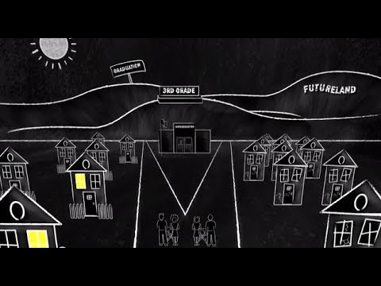
Welcome!
Notes:
Introduce yourself with an adjective that describes you, but also begins with the first letter of your first name. For example, “Brilliant Brandie”

Slide 3


Although schools must be accountable for helping all children achieve, providing effective teaching for all children in every classroom every day, the Campaign is based on the belief that schools cannot succeed alone.
Engaged communities mobilized to remove barriers, expand opportunities, and assist parents in fulfilling their roles and responsibilities to serve as full partners in the success of their children are needed to assure student success.
The work is about supporting communities and families in the four focus areas of: school readiness, attendance, high quality instruction, and extended learning.
Notes:
Our Mission: We strategically work with educators and stakeholders to empower schools and communities to foster learning environments focused on school readiness, attendance, extended learning and high quality instruction.

Slide 4
The Goal:
Increase the number of WV children reading proficiently by the end of third grade by
5%
points annually.

Slide 5
Key Areas
School Readiness
Attendance
Extended Day/Year Learning
High Quality Instruction

Slide 6
High-Quality Instruction

Slide 7
John Hattie is Professor of Education at the University of Auckland, New Zealand.
20 years research studying the typical effect across 800+ meta-analyses, 50,000 studies, and 200+ million students ages 4-20.
Speaks to the fallacy of using the “zero” point to determine an increase in student achievement.

Slide 8
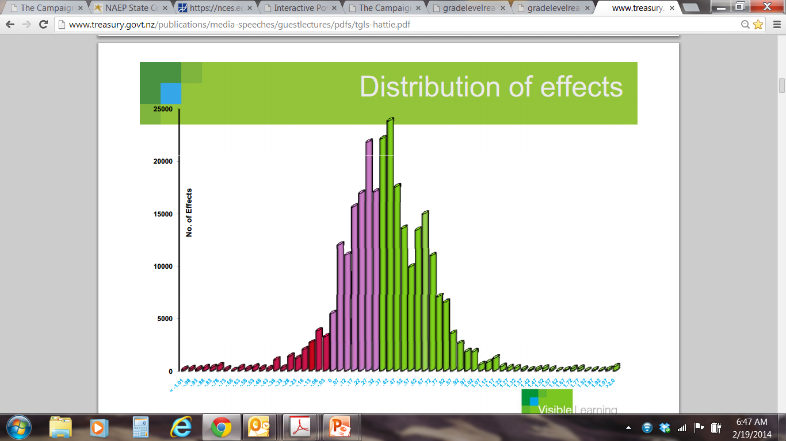

Slide 11
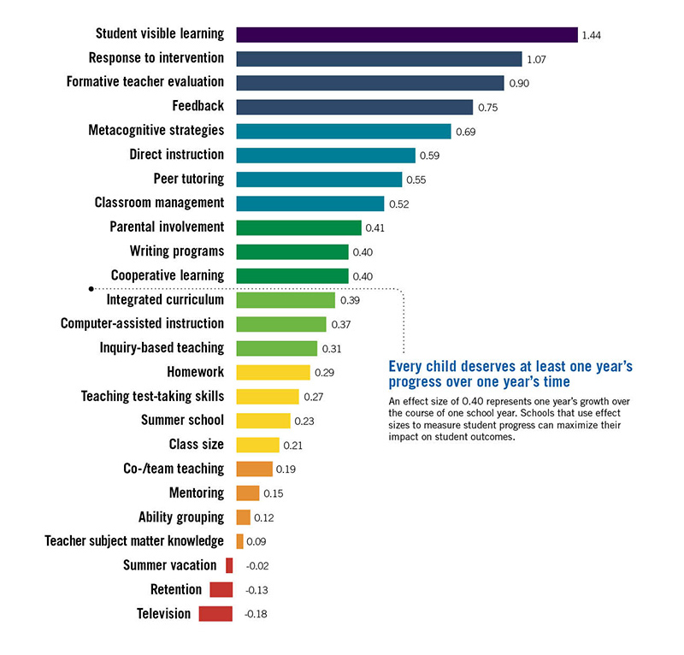

Slide 17
How does that connect to high-quality instruction?

Slide 18
Ruby Payne
Issues facing children in poverty:
Inability to plan
Casual Register of Speaking

Slide 19
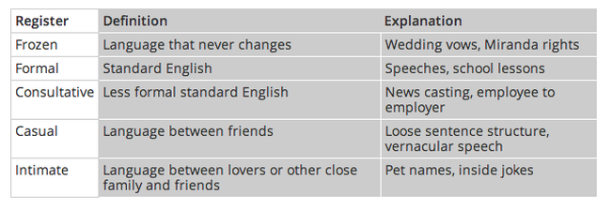
Registers of Language

Slide 20
Registers of Language

Slide 21
How does this affect cognition?
If an individual depends upon a random, episodic story structure for memory patterns, lives in an unpredictable environment, and has not developed the ability to plan, then….
If an individual cannot plan, s/he cannot predict.
If an individual cannot predict, s/he cannot identify cause and effect.
If an individual cannot identify cause and effect, s/he cannot identify consequence.
If an individual cannot identify consequence, s/he cannot control impulsivity.

Slide 22
What’s the answer?
Increase the opportunity for discourse.

Slide 23
TEACHER RESPONSIBILITY
“I do it”
Focus Lesson
Guided Instruction
“We do it”
“You do it
together”
Collaborative
Independent
“You do it
alone”
STUDENT RESPONSIBILITY
A Model for Success for All Students
Fisher, D., & Frey, N. (2008). Better learning through structured teaching: A framework for the gradual release of responsibility. Alexandria, VA: Association for Supervision and Curriculum Development.

Slide 24
But…

Slide 25
In some classrooms …
TEACHER RESPONSIBILITY
“I do it”
Focus Lesson
“You do it
alone”
Independent
STUDENT RESPONSIBILITY
Fisher, D., & Frey, N. (2008). Better learning through structured teaching: A framework for the gradual release of responsibility. Alexandria, VA: Association for Supervision and Curriculum Development.

Slide 26
And…
In the worst classrooms …
TEACHER RESPONSIBILITY
(none)
“You do it
alone”
Independent
STUDENT RESPONSIBILITY
Fisher, D., & Frey, N. (2008). Better learning through structured teaching: A framework for the gradual
release of responsibility. Alexandria, VA: Association for Supervision and Curriculum Development.

Slide 27
And Still…
In the “Good Enough” Classroom
TEACHER RESPONSIBILITY
“I do it”
Focus Lesson
Guided Instruction
“We do it”
“You do it
alone”
Independent
STUDENT RESPONSIBILITY
Fisher, D., & Frey, N. (2008). Better learning through structured teaching: A framework for the gradual
release of responsibility. Alexandria, VA: Association for Supervision and Curriculum Development.

Slide 28
Collaboration
65% of class time should be collaborative discussions.
That’s 39 minutes out of every 60 minutes.

Slide 29

How do I demonstrate value and respect for all students?
Dr. Robert Marzano describes this as identifying high-expectancy and low-expectancy students. The term “low-expectancy” has nothing to do with the students, it has to do with the perceptions of the teacher.

Slide 30
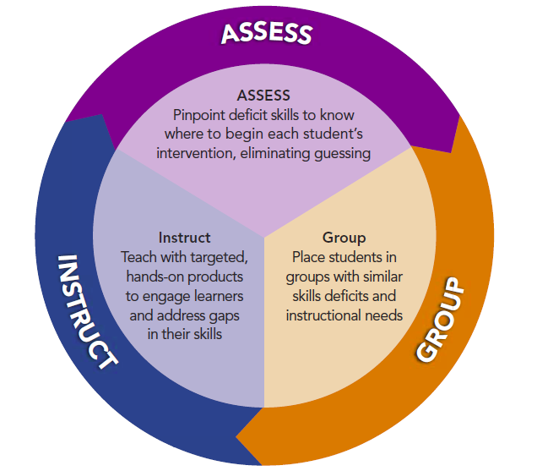

Slide 31
Formative & Summative Assessment
Notes:
https://www.teachingchannel.org/videos/gathering-data-to-inform-instruction-ousd
https://www.youtube.com/watch?v=FoXOAVMp0EM (many examples)

Slide 32
Why do we assess?
"The true purpose of assessment must be, first and foremost, to inform instructional decision making. Otherwise, assessment results are not being used to their maximum potential – improving student achievement through differentiated instruction."
-- Ainsworth and Viegut, 2006, pp. 21-22
Notes:
This makes sense when you think about the root word for assessment:

Slide 33
Two Views of Assessment
Assessment is for:
Nurturing
Guiding
Self-Reflection
Information
Comparison to task
Use over multiple activities
Assessment is for:
Gatekeeping
Judging
Right Answers
Control
Comparison to others
Use with single activities

Slide 34
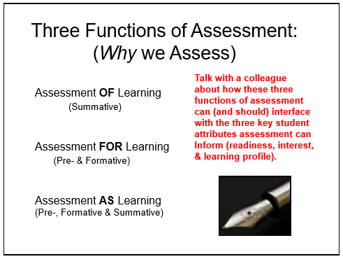
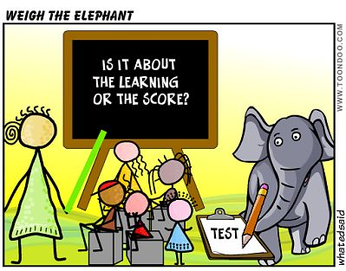

Slide 35
We assess to...
Monitor development and learning
Guide our planning and decision making
Identify children who might benefit from special services or support
Report and communicate with others

Slide 36
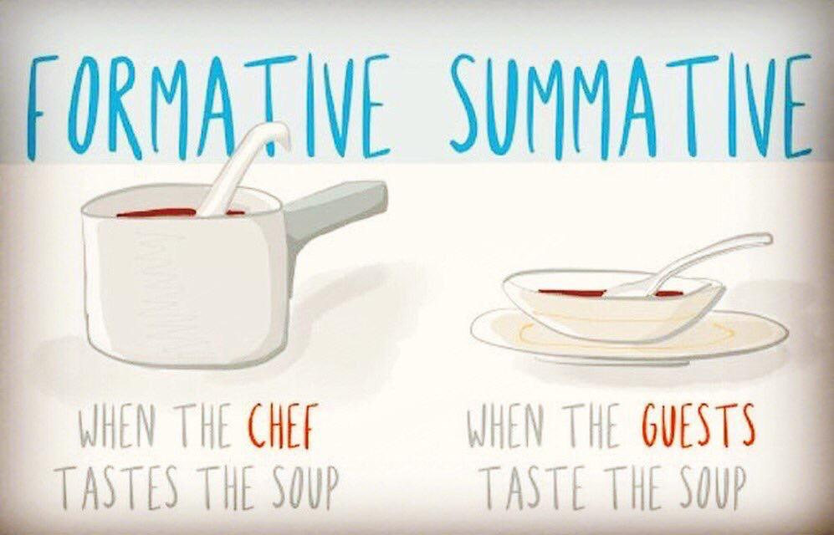

Slide 37
Bigger is not better

Slide 38
More often is better
Notes:
Common formative assessments should be conducted more often than benchmark assessments, certainly. However, remember, just because you weigh the chicken every day does not mean that it’s weight is going to change. You have to feed it every day for it to grow. The assessment without change in instruction is summative, not formative.

Slide 39
Goldilocks’ Approach
-enough to gain useful information
-not so much that it overwhelms

Slide 40
You don’t need to reinvent the wheel.
…but you do need to kick the tires.
Notes:
Interims
Using published or previously developed tests are not prohibited but don’t blindly accept their quality or appropriateness. Review collaboratively before using/ exercise professional judgement.

Slide 41
Not necessarily about grading, but they are about feedback.

Slide 42
Best Practices for Standards-based Instruction
Student Work & Assessment
From
To
Products for teacher / grading
No student work displayed
Identical, imitative products
Feedback = scores or grades
Seen / scored only by teacher
Products for real events / audience
High quality / all students
Varied and original products
Substantive, varied, formative feedback
Public displays and performances

Slide 43
Assessments & Documentation
PALS
Anecdotal notes
Student work samples
Pictures
Graphic organizers
Exit slips

Slide 44
Remember…
Begin and End with the Standards!
  What is the goal?
  Work backwards.
  What evidence is acceptable?
  Work towards mastery.
Notes:
Performance tasks

Slide 45
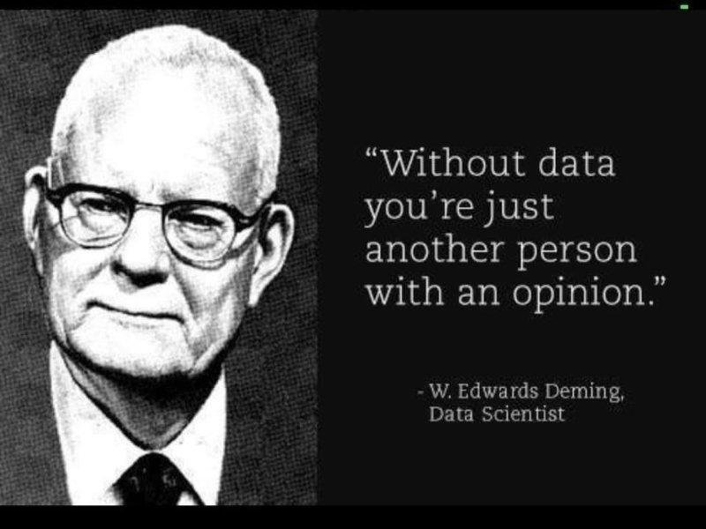
Notes:
Maggie
Wrap up

Slide 46

Share how your institution instructs pre-service teachers on assessing students.
Do your pre-service teachers have opportunities to assess students? You can include formative or summative assessments in your response.

Slide 47
Balanced Reading Diet

Slide 48

Balanced Reading Diet
Notes:
Correct balance of nutrients
The right balance of instruction

Slide 49
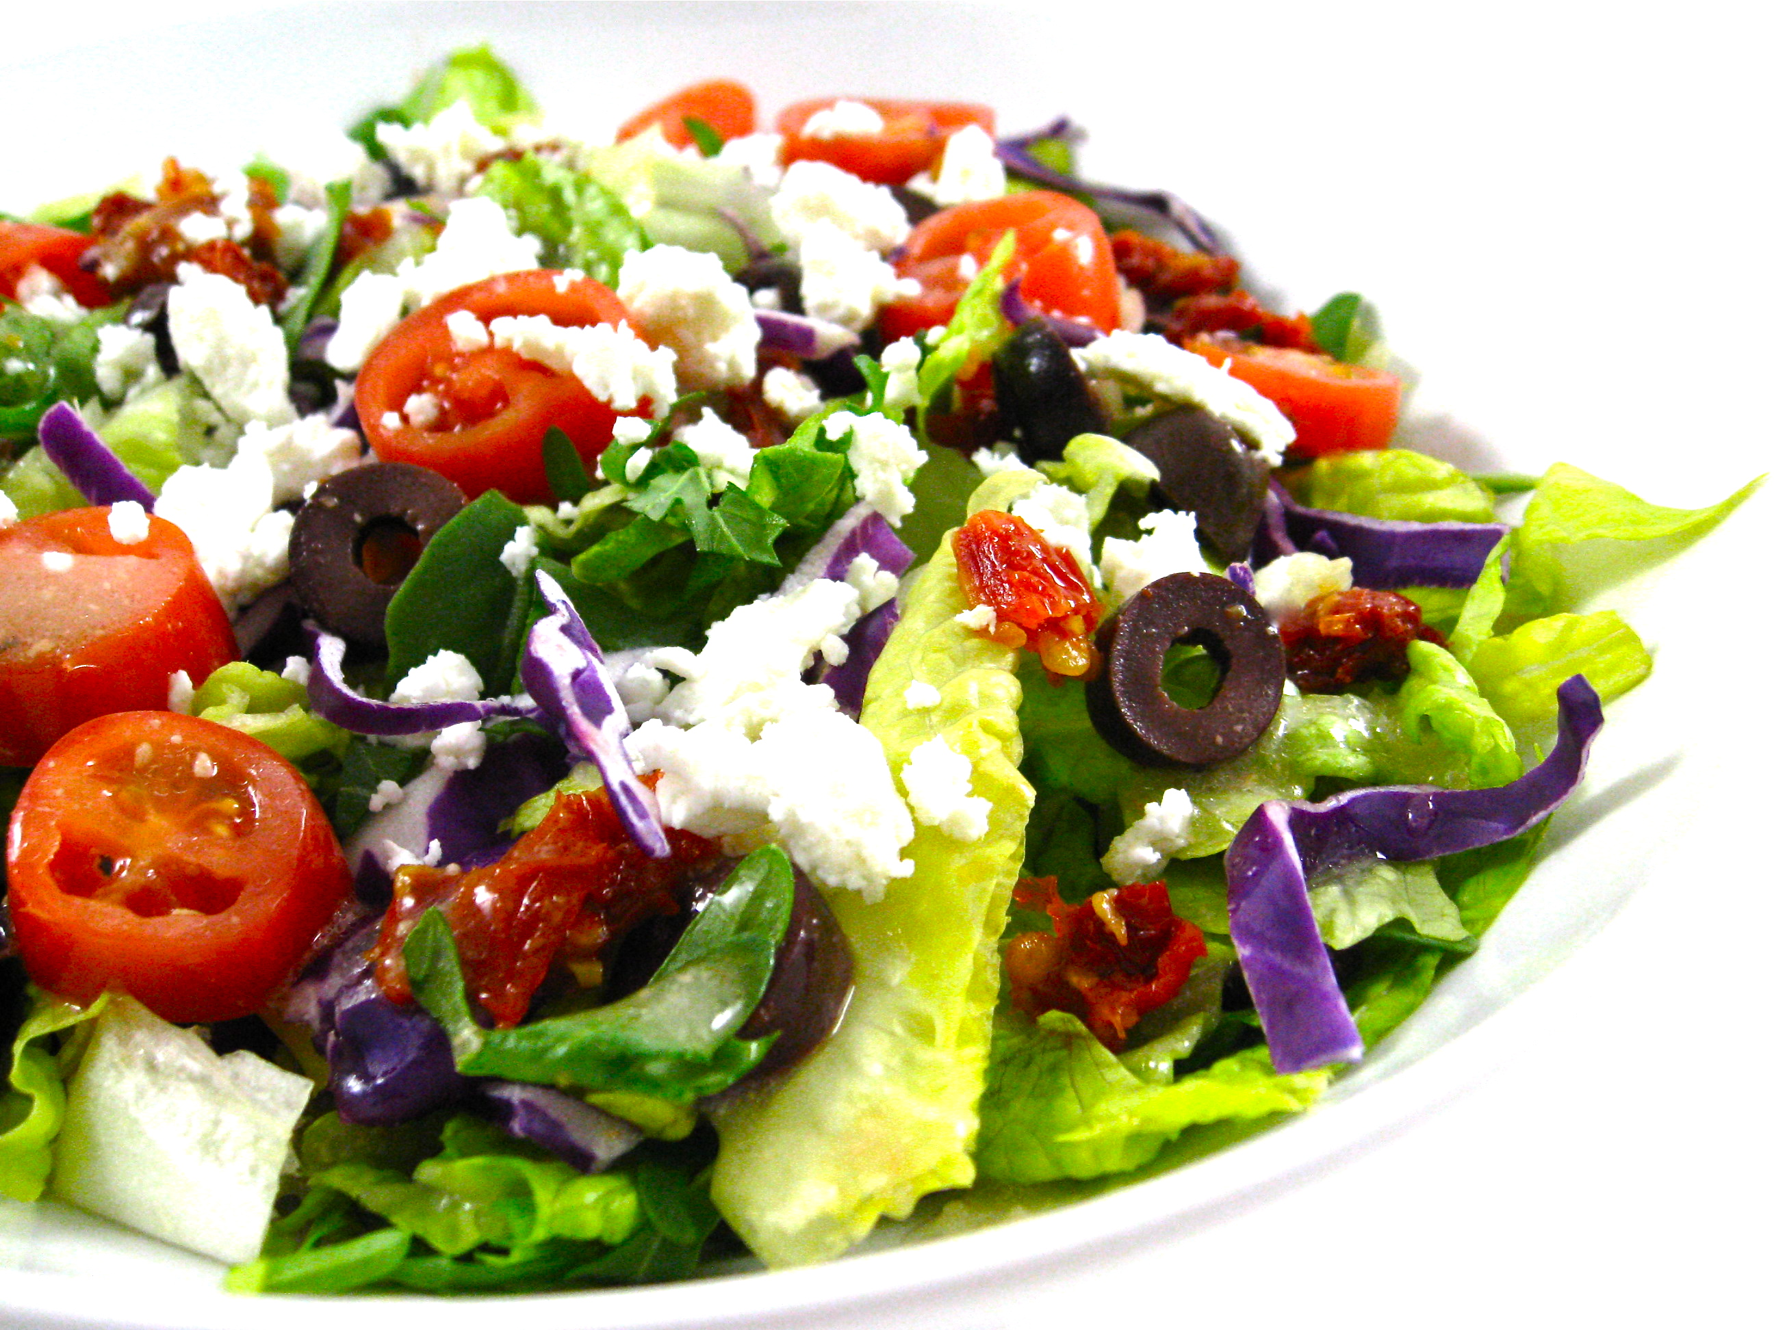
Balanced Reading Diet

Slide 50
Emergent Readers:
Develop phonological awareness
Develop print awareness and concepts of print
Learn about letters and sounds
Experiment with writing, using letters or letter-like forms

Slide 51
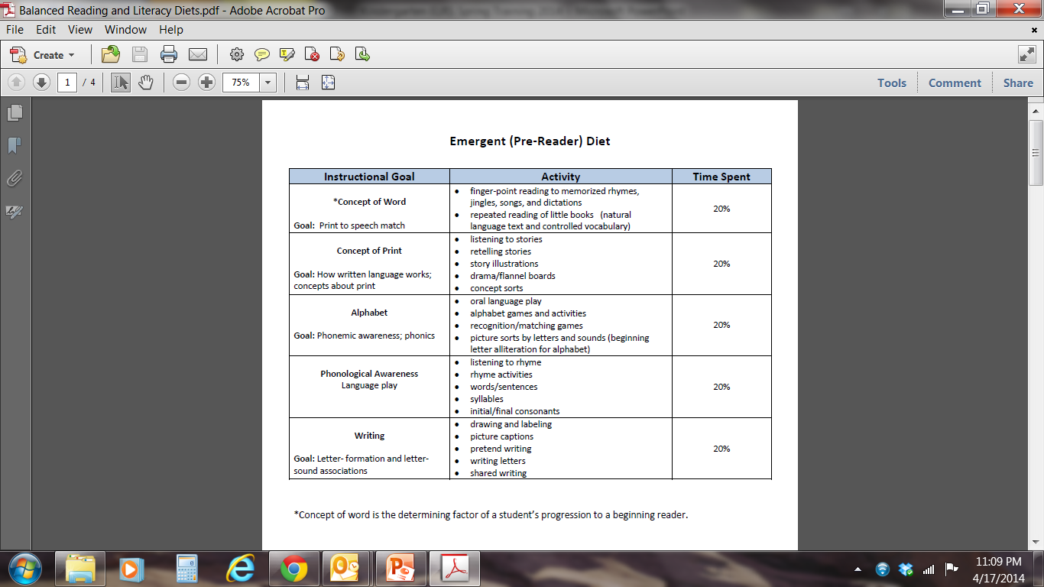
Notes:
Tracy

Slide 52
Beginner Readers:
Learn to read and write high frequency words
Learn to decode and spell single syllable words
Use pictures and print to construct meaning, both in reading and in their writing
Are acquiring fluency
Reread to self correct and attend well to print.

Slide 53
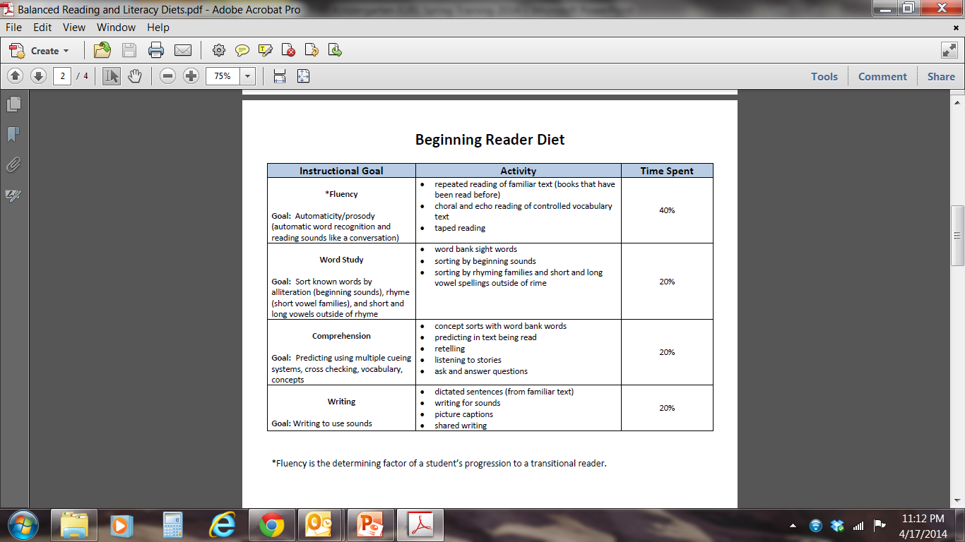

Slide 54
Transitional Readers:
Are gaining in fluency
Have good decoding skills but may lack comprehension
Have difficulty with decoding longer words or certain vowel patterns
Are making the transition to silent reading and are learning to do more editing and revising

Slide 55
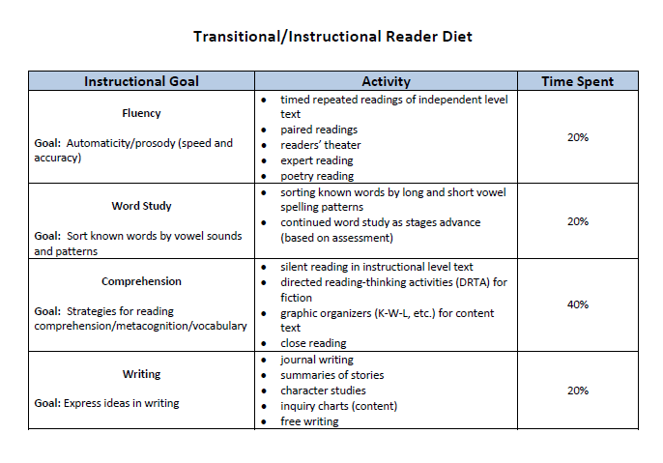

Slide 56
Instructional Resources
Professional Learning Guides
Instructional Webinars
PALS website

Slide 57
Share how your institution trains pre-service teachers to provide literacy instruction.
Do your pre-service teachers have exposure to the Balanced Reading Diet framework?
Is there one component from the diet that you feel is more heavily addressed than the others?

Slide 58
Small Group Instruction

Slide 59
What is a literacy work station?
An area within the classroom where students work alone or interact with one another, using instructional materials to explore and expand their literacy
(Diller, 2003)

Slide 60
Literacy work stations
provide a means to implement quality independent practice of previously taught literacy objectives.
may be used to support distributive practice, differentiation, and engagement for students while teachers work with small, flexible groups of students.

Slide 61
Principles for Teaching with Literacy Work Stations
Focus on practice and purpose, not the stuff
Link to your teaching
Slow down to speed up
Balance process and product
Less is more. Don’t put out too much at once
Use Novelty
Simplify

Slide 62
Flexible Grouping
Students consistently working in a variety of purposefully planned groups…
…based on different elements of student learning…
…and both homogeneous and heterogeneous in regard to those elements…
Tomlinson (2003) Fulfilling the Promise of the Differentiated Classroom.

Slide 63

Grouping with pals
Sample report for classroom
Multi-class grouping function: http://www.screencast.com/t/u0KgnmmnMTx

Slide 64
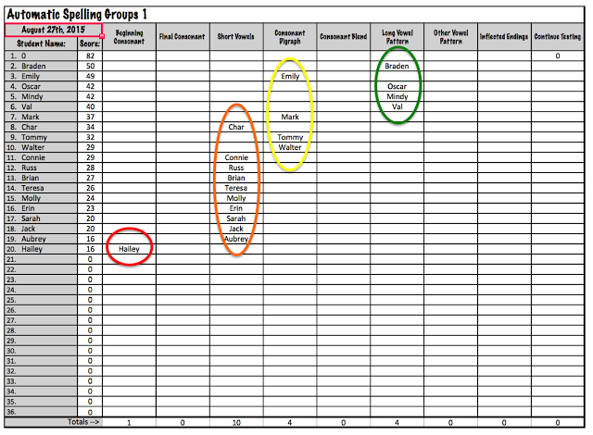
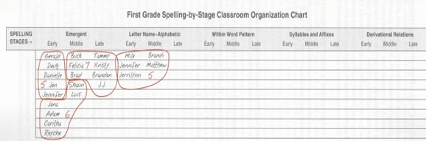
Grouping with Words Their Way or other spelling assessments

Slide 65
Mini lessons
Mini Lessons
Short and Focused (5 to 10 minutes)
Explicit
Types of Mini Lessons
  Beginning of the year how-to’s
  Introducing a work station
  After adding something new
  Reviewing work station activities
  Anchor charts
  I Can Lists
  Introducing new skills
  Reinforcing skills

Slide 66

Gradual release of responsibility: SKILLS
Mini lesson
Model
Mini lesson
Practice in whole group
Independent work in stations

Slide 67
Best Practices for Standards-based Instruction
Activities & Assignments
From
To
Teacher presentation
Whole-class instruction
Uniform curriculum
Short-term lessons
Memorization and recall
Short responses, fill-in-the-blank
Same assignments
Students experiencing concepts
Centers, groups, variety
Topics by students’ needs or choice
Extended activities
Application and problem solving
Complex responses, evaluations and writing
Multiple intelligences, cognitive styles

Slide 68
Share how your institution trains pre-service teachers to provide small group instruction.
Do your pre-service teachers have opportunities to utilize assessment data to create small groups?

