Slide 2
WV Kindergarten Teacher System of Support
Notes:
Rhonda

Slide 3
Overall Recommendations
Strengthening of Instructional Supports, Learning Activities, Accessibility and Interactions.
Use Data to inform PD and support this process of continuous improvement with LEAs.
Support processes of transition and closer alignment between Pre-K and K.
Pre-K and K-3 teachers as teams.
Strengthening PD around developmentally appropriate practices with a focus on standards.
Supporting PD that focuses on teachers’ differentiation so that gains in Pre-K are sustained in K (and beyond).
Notes:
TRANSITION, TRANSITION TO K

Slide 4
Thank You For Participating
The WVDE Office of Early & Elementary Learning is excited to pilot a year-long Kindergarten Classroom System of Support that will provide sustained professional learning and resources for kindergarten educators. Throughout the year, participating kindergarten teachers will explore ways to deepen classroom effectiveness in English Language Arts and Mathematics, while focusing on various aspects of high-quality kindergarten programming and support for evidence of learning.

Slide 5
The CLASS

Slide 6
The CLASS - Foundation
The CLASS dimensions are based on developmental theory and research suggesting that interactions between students and adults are the primary mechanism of student development and learning.
The dimensions are based solely on interactions between teachers and students in classrooms; this system does not evaluate the presence of materials, the physical environment or safety, or the adoption of a specific curriculum.
(Greenberg, Domitrovich, and Bumbarger, 2001; Hamre and Pianta, 2007; Morrison and Connor, 2002; Pianta 2006; Rutter and Maughan, 2002)
Notes:
Tracy - Observation Tool, UVA,

Slide 7
Classroom Quality
Emotional Support
Positive climate
Negative climate
Teacher sensitivity
Regard for student perspectives
Classroom Organization
Behavior management
Productivity
Instructional learning formats
Instructional Support
Concept development
Quality of feedback
Language modeling
Notes:
Tracy

Slide 8
Emotional Support - Dimensions
Positive Climate
Negative Climate
Teacher Sensitivity
Regard for Student Perspectives
Notes:
Tracy

Slide 9
Positive Climate: Reflects the emotional connection between the teacher and students and among students and the warmth, respect, and enjoyment communicated by verbal and nonverbal interactions.
Indicators: Evidence of relationships, positive affect, positive communication, and respect.
Negative Climate: Reflects the overall level of expressed negativity in the classroom; the frequency, quality, and intensity of teacher and peer negativity are key to this scale.
Indicators: Evidence of negative affect, punitive control, sarcasm/disrespect, and severe negativity.
Notes:
Greek – to slash

Slide 10
Teacher Sensitivity: Encompasses the teacher's awareness of and responsivity to student's academic and emotional needs; high levels of sensitivity facilitate students' ability to actively explore and learn because the teacher consistently provides comfort, reassurance and encouragement.
Indicators: Teacher awareness, responsiveness, addressing problems, and student comfort.
Regard for Student Perspectives: Captures the degree to which teacher's interactions with students and classroom activities place an emphasis on students' interests, motivations, and points of view and encourage student responsibility and autonomy.
Indicators: Evidence of flexibility and student focus, support for autonomy and leadership, student expression, restriction of movement.

Slide 11
Classroom Organization - Dimensions
Behavior Management
Productivity
Instructional Learning Formats
Notes:
Tracy

Slide 12
Behavior Management: Encompasses the teacher's ability to provide clear behavioral expectations and use effective methods to prevent and redirect misbehavior.
Indicators: Evidence of clear behavior expectations, proactivity, redirection of misbehavior, and student behavior
Productivity: Considers how well the teacher manages instructional time and routines and provides activities for students so that they have the opportunity to be involved in learning activities.
Indicators: Evidence of maximizing learning time, routines, transitions, and preparation

Slide 13
Instructional Learning Formats: Focuses on the ways in which the teacher maximizes student interest, engagement, and the ability to learn from lessons and activities.
Indicators: Evidence of Effective facilitation, variety of modalities and materials, student interest, and clarity of learning objectives

Slide 14
Instructional Support - Dimensions
Concept Development
Quality of Feedback
Language Modeling
Notes:
Tracy

Slide 15
Concept Development: Measures the teacher's use of instructional discussions and activities to promote students' higher-order thinking skills and cognition and the teacher's focus on understanding rather than rote instruction.
Indicators: Evidence of analysis and reasoning, creating, integration, and connections to the world around them.
Quality of Feedback: Assesses the degree to which the teacher provides feedback that expands learning and understanding and encourages continued participation.
Indicators: Evidence of scaffolding, feedback loops, prompting thought processes, providing information, and encouragement and affirmation
Notes:
Encouraging analysis and reasoning through discussions and activities
Asking students to explain thinking

Slide 16
Language Modeling: Captures the quality and amount of the teacher's use of language-stimulation and language-facilitation techniques.
Indicators: Evidence of frequent conversation, open-ended questions, repetition and extension, self- and parallel talk, and advanced language

Slide 17
West Virginia’s
Imagination Library Program

Slide 18
Why Imagination Library?
Dolly Parton’s Imagination Library has been a key component of our school readiness strategy and is in alignment with the Campaign for Grade-Level Reading.

Slide 19
Imagination Library Transition
As a result of HB 4006, the program was transitioned to WVDE.
WVDE plans to expand the program to all 55 counties.
To assist in reaching that goal, WVDE has partnered with Marshall University's June Harless Center
Notes:
I took this information from the press release that was published so it is all safe to share. Feel free to trim it down if you want, I just wanted you to have all of the language.

Slide 20
What is the Imagination Library?
Inspires a love of reading
Guarantees all children will have quality books in the home
A program about inspiration and imagination
Started in 1995 by Dolly Parton for the children in her hometown of Sevier County
In 2000 program went nationwide

Slide 21
The Library
Books are:
New
Age Appropriate
Mailed directly to the Child in his/her name
First book = “Little Engine That Could”
Last Book = “Look Out Kindergarten Here I Come”
The first and last book includes a letter from Dolly!

Slide 22
Why We Do It
Early Literacy Matters
Vocabulary development by age 3 is found to predict achievement by 3rd grade.
Reading aloud is widely recognized as the single most important activity leading to literacy acquisition.
Children raised in homes with as few as 25 books complete an average of 2 more years of schooling than those with no books.
Imagination Library is a monthly reminder to spend time reading to a child.
Brain Development
Age 3
80%
Age 5
90%
Notes:
Meta- analysis pdf

Slide 23
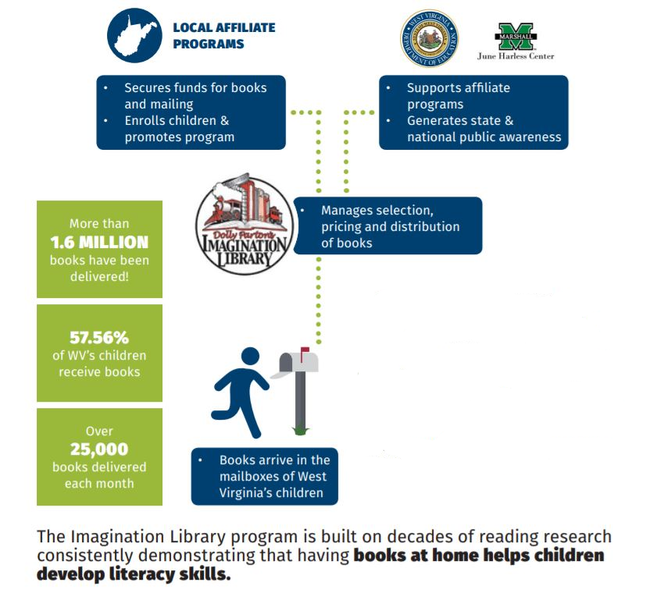
How it Works
Partnership between Dolly Parton’s Imagination Library, the WVDE, Marshall University’s June Harless Center and local affiliates

Slide 24
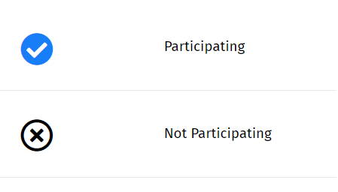
Participating Counties

Slide 25
What it Costs
Provides for the purchase and delivery of 12 books to 1 child for a full year.
Provides for the purchase and delivery of 12 books for 1 child for 3 years.
Provides the entire Imagination Library -60 books- to 1 child over 5 years.
Directly funds the purchase and delivery of books to WV children.
Every cent goes toward the purchase of new books for children.
Any
Amount
$25
$75
$125

Slide 26
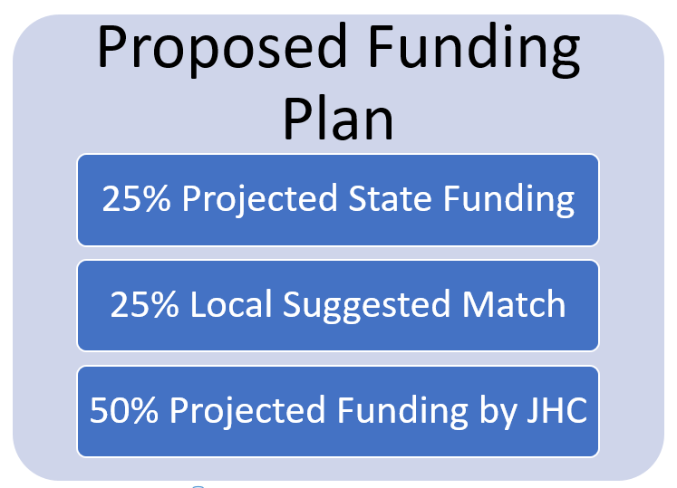
3-Year Proposed Funding Plan

Slide 27
How Can YOU Help?
Start a Program
Raise funds
Enroll every child
Read with a child
Help families engage
Pay it forward: Donate
Spread the word

Slide 28
Resources
IL Toolkit
https://imaginationlibrary.com/
https://wvde.us/west-virginias-imagination-library/

Slide 29
Contact Us
Charlotte Webb
Program Coordinator
Email: ctwebb@k12.wv.us
Brooke Green
Registration Coordinator
Email: brooke.green@k12.wv.us
Dr. Stan Maynard
Executive Director, June Harless Center
Email: maynard@marshall.edu
Brandie Turner
Funding Coordinator
Email: brandie.turner@k12.wv.us

Slide 30
Coaching Project Overview
Higher Education
April 25, 2019
Notes:
Through the work of the Coaching Academy, it has become evident that providing teachers with sustained professional learning via instructional coaches allows teachers the time, reflection, focus, and collaborative partnership needed to impact their own learning and the learning of their students. This session will provide an overview of why instructional coaching matters and some best practices to begin implementation of a coaching model in your school and/or county.

Slide 31
WV Standards for Professional Learning
Occurs within learning communities committed to continuous improvement, collective responsibility and goal alignment.
Requires skillful leadership to develop capacity, advocate and create support systems for professional learning.
Requires prioritizing, monitoring and coordinating resources for educator learning.
Uses a variety of sources and types of student, educator and system data to plan, assess and evaluate professional learning.
Integrates theories, research and models of human learning into learning designs to achieve its intended outcomes.
Applies research on change and sustains support for implementation of professional learning for long-term change.
Aligns outcomes with educator performance and student curriculum standards.
Notes:
We don’t have time to go through these in detail today, but just so you know West Virginia does have professional development standards and coaching done right aligns with them beautifully.

Slide 32
Coaching is most effective
Valid use of resources
Sustainable
Notes:
Shows student achievement through staff development and as you can clearly see coaching had the most significant impact on students outcomes.

Slide 33
Instructional Coaches
"Instructional coaches partner with teachers to analyze current reality, set goals, identify and explain teaching strategies to meet goals, and to provide support until the goals are met."
-Impact Research Lab
The Impact Cycle (2018, p. 3)
Notes:
We came from a place of supporting true coaching… this is what that should looklike.

Slide 34
Three Approaches to Coaching
Three Approaches to Coaching
Characteristic | Facilitative | Dialogical | Directive
Metaphor | Sounding board | Partner | Expert-Apprentice
Teacher Knowledge | Knows what they need to know to improve | Has valuable knowledge but may need other knowledge to improve | Must implement new knowledge to improve
Decision Making | Teacher | Teacher | Coach
Approach | Does not share expertise | Shares expertise dialogically | Shares knowledge directly
Focus | Teacher/Student | Student | Teaching practice
Mode of discourse | Inquiry | Balances advocacy with inquiry | Advocacy
Notes:
Dialogical is a mix of some of the other approaches and really honors the partnership between teacher and coach.

Slide 35
Dialogical
Dialogical
Partner
Teacher’s knowledge is clearly valued, and coach’s knowledge of evidence-based teaching strategies is often very helpful
Coach shares expertise, but dialogically
Coach and teacher think together
Teacher makes the decision
Accountability is to the students
Notes:
Is truly a partnership

Slide 36
Dialogical
Dialogical
Partner
Student-focused goals identified together
Standard for excellent implementation is the goal itself
Positions teachers as decision makers
Balance of the other two approaches

Slide 37
Instructional Coaching
Instructional Coaches help teachers:
Identify a clear picture of reality
Identify a goal
Identify a teaching strategy to hit the goal, and help them learn the new strategy
Collaborate with teachers to help make adaptations until the goal is met
Notes:
Coaches do these four things with teachers… over and over again
Identify a goal, identifying a strategy, and collaboration will be what we are talking about more today in this session

Slide 38
Getting a Clear Picture of Reality
Coaching is unlikely to succeed unless both the teacher and the coach see clearly what is happening in the classroom.
Both coach and teacher need to develop a shared understanding of what is happening in the classroom.
When teacher and coach understand the top priority for change in the classroom, they can address that priority with laser-like focus.
That same picture of reality also establishes a baseline for growth.
Notes:
Let’s start with getting a clear picture of reality…
Video is the best way to do that
What must happen first to make things better
And then understanding where we starting from…

Slide 39
The Illusion of Objectivity
The reason most of us struggle to see reality clearly is that we look at life through an illusion of objectivity. We think we see the world exactly as it is, but the opposite is true. We make our own meaning out of what we experience, including what we don't understand, and as a result, the meaning we create is often wrong.
Notes:
Here’s what makes it so hard to gain a clear picture of reality without video… Because as human beings we stuggle…

Slide 40
Common Perceptual Errors
Confirmation Bias
Habituation
Primacy Effect
Recency Effect
Stereotypes
Notes:
Here are some common forms of bias that all or most people struggle with

Slide 41
Confirmation Bias: Our natural tendency to color our perceptions of reality by consciously or unconsciously seeking data that support our assumptions about the world around us.
Habituation: Our tendency to become desensitized to any experience, positive or negative, that we experience repeatedly.
Stereotypes: Our tendency to prejudge people as having the characteristics of a group (often negative), which blinds us to the unique characteristics of individuals.
Notes:
Behavior management examples
Team of teachers

Slide 42
Primacy Effect: Our tendency in our first experiences with someone or something to be biased in favor of a particular impression of that person or thing.
Recency Effect: Our tendency in our last experiences with someone or something to be biased in favor of a particular impression of that person or thing.
Notes:
So if you observe 5 classrooms in a day, you are more likely to remember the first and last as favorable.

Slide 43
Let's Test the Theory
Haystack
Pin
Button
Thread
Injection
Shark
Pain
Sewing
Thimble
Splinter
Eye
Stitch
Notes:
Needle... Comfirmation bias

Slide 44
Three Strategies to Get a Clear Picture of Reality
Video Recording
Learning From Students
Gathering Observation Data
Notes:
Because of time today, we will focus on the most effective of these strategies… Video Recording

Slide 45
Big Ideas Related to Using Video
Teachers need to own their videos and control their use
Teacher and coach should watch the initial video separately
The first video should be at least twenty minutes long
More insight is gained when the video records both teacher and students

Slide 46
The Impact Cycle
Identify:
Teacher gets a clear picture of reality by reviewing observational data
Coach asks identify questions with the teacher to identify a goal
Teacher identifies a student focused goal
Improve:
Coach prompts teacher to modify the practice if teacher wishes
Teacher sets time to implement practice
Learn:
Teacher implements practice
Data is gathered
Coach and teacher meet to confirm direction and monitor progress
Coach and teacher make adaptations and plan next actions until the goal is met
Notes:
Handout

Slide 47
Review of the Impact Cycle
Impact Cycle Overview
Notes:
Play Video for the First 2:35 Only!!! Or if short on time 1:54… will work.

Slide 48
Identify Questions
These questions can be used to help teachers identify a PEERS goal. (Powerful, Emotionally compelling, Easy, Reachable, Student focused)
1. On a scale of 1-10, with 1 being the worst lesson you’ve taught and 10 being the best, how would you rank that lesson.
2. What pleased you about the lesson?
3. What would have to change to move the lesson closer to a 10?
4. What would your students be doing differently if your class was a 10?
5. Tell me more about what that would look like.
6. How could we measure that change?
7. Do you want that to be your goal?
8. If you could hit that goal, would it really matter to you?
9. What teaching strategy can you use to hit your goal?
10. What are your next steps?
Notes:
These 10 questions are used in conversation with a teacher in order to set a goal for improvement.

Slide 49
PEERS Goals
Powerful- the goal is going to make a significant difference in students’ lives and learning
Emotionally Compelling- matters a lot to the teacher
Easy- simple, clear, and easy to understand
Reachable- identifies a measurable outcome and strategy
Student-focused-provides clear feedback on whether changes made a difference in students’ achievement, behavior, or attitudes
Notes:
Goals should be…

Slide 50
Videos of Crysta and Jim Knight
Crysta Uses Video to Get a Clear Picture of Reality
Crysta Answers the Identify Questions to Set a PEERS Goal
Crysta Identifies a Teaching Strategy to Use to Hit Her Goal
Notes:
Stacey

Slide 51
Final Thoughts…
You cannot pressure people into improvement. There is no evidence that it works, but you can motivate people into better practice.

Slide 52
Questions…
Tracy Komorowski
tbkomorowski@k12.wv.us
(304) 654-1438
Notes:
Remind them to take the survey!!

Slide 53
Writing Academy Updates
Maggie Luma

Slide 54
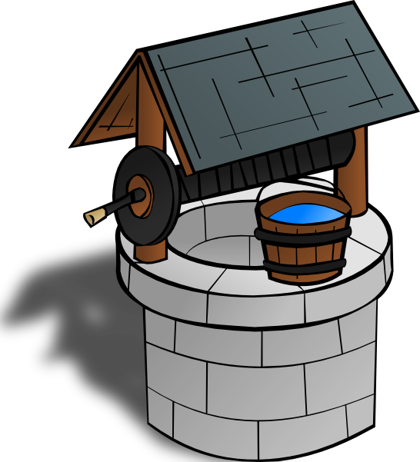
WRITING
READING
Notes:
Graham & Hebert (2010) review of more than 110 studies
Writing about text improves comprehension and learning from text
Studies show a close relationship between reading and writing in the primary grades
The major overlaps at these ages are between the phonological and orthographic aspects of reading and writing
Specifically, decoding skills are related to encoding skills
Engaging students in spelling invention or developmental writing in which children spell words as they think they are spelled is valuable practice
More extensive writing is more effective than shorter writing
Differences in benefits unless explicit writing instruction is provided

Slide 55
SRSD: Self-Regulated Strategy Development
Notes:
“SRSD* integrates all major learning theories into a practical set of strategies that enable teachers to see growth in both literacy and student independence. SRSD foregrounds writing & reading with deep attention to purpose, task, audience and social context. Developed by Dr. Karen Harris & colleagues, SRSD is fueled by 35 years of research and innovation.”
Over 125 peer reviewed published studies on SRSD
IES What Works Clearing House validation of SRSD
On average, schools that work with thinkSRSD have a 7% gain on state assessments (specific ELA data from schools following think SRSD’s Support plan is attached)
Results based on 25 schools and districts state summative assessments:

Slide 56
SRSD: Writing for Everyone
Notes:
Disaggregated data for one district implementing SRSD shows that there are positive effects on all learners, especially those in special education:

Slide 57
Why SRSD?
Characteristics of Strategic Learners | Characteristics of Non-Strategic Learners
Able to analyze a problem and develop a plan Access their background knowledge and apply it to novel tasks Develop new organizational or procedural strategies as the task becomes more complex Use effective self-regulated strategies while completing a task Attribute high grades to hard work Review task-oriented-goals and determine whether they have been met | Unorganized, impulsive, unaware where to begin an assignment Unaware of possible steps to break the problem into a manageable task Exhibit problems with memory Unable to focus on a task Lack persistence Experience feelings of frustration, failure, anxiety Attribute failure to uncontrollable factors (e.g., luck, teacher’s instructional style)
Notes:
Do any of you have student that fall into the second category?
The IRIS Center. (2008). SRSD: Using learning strategies to enhance student learning. Retrieved from https://iris.peabody.vanderbilt.edu/module/srs/
Self-regulation instruction helps students to learn strategies that can improve their self-control and performance of their own manner of learning. Self-regulation strategies are often taught in tandem with academic strategies and can improve student outcomes. For example, students might be taught a persuasive essay writing strategy along with a strategy for self-regulating their writing. These evidence-based strategies:
Reduce disruptive problems in the classroom
Empower students by allowing them to reinforce their own behavior
Are simple to use and inexpensive to incorporate
Can be taught to students in all grades

Slide 58
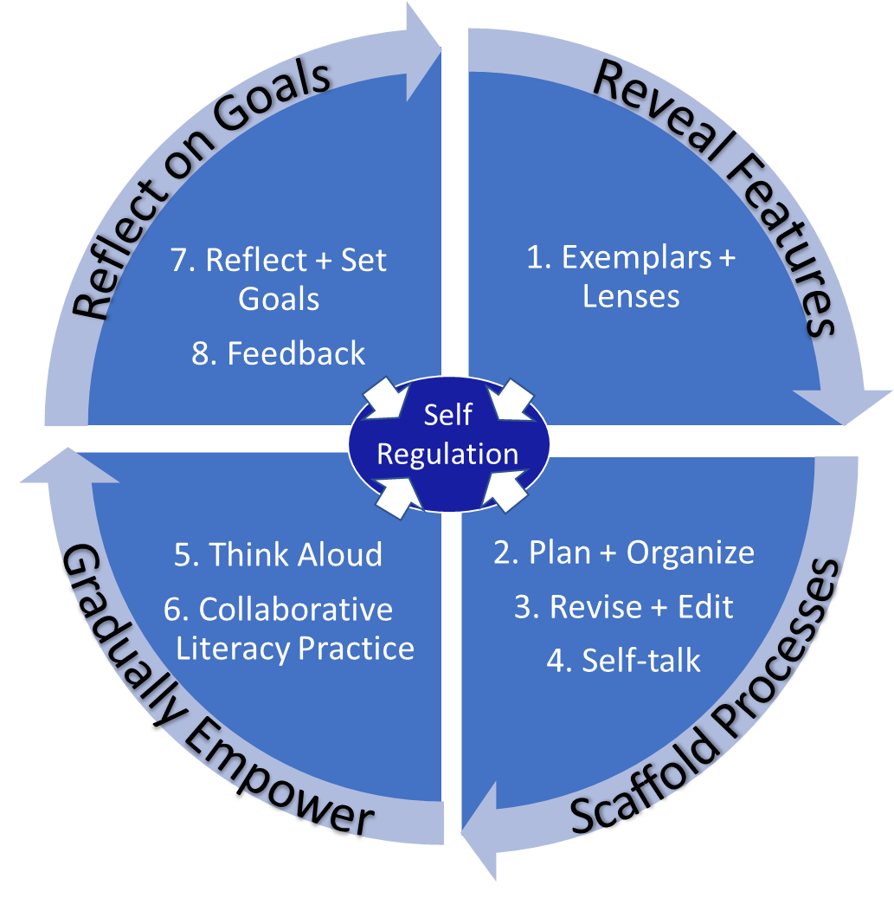
Notes:
2- Dive into 8 Rs – come from evid 35+ yrs, 100s of studies). 8 ebp routines for tchg WP easier, effect & enjoyable. Take around the wheel – SR, agency, at center. Strat’s not enough – need to self-reg. Compr (everything here). (This is on

Slide 59
1. Exemplars and Lenses

Slide 60
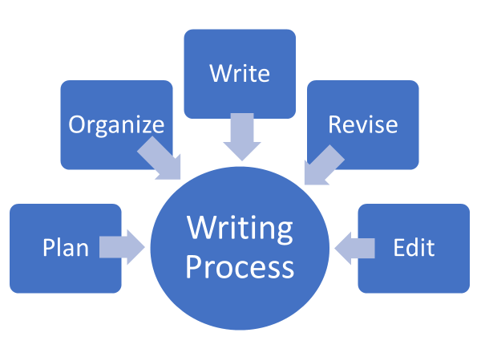
Scaffolds: Mnemonics
Plan - Pull apart the task (Do What?) / Pick Ideas (list, circle, web, etc.)
Organize ideas (TIDE)
Write, and say more
Revise
Edit

Slide 61
Scaffolds: Mnemonics
Topic
Important evidence
Detailed examination (analysis)
End
Notes:
We do not give mneumonics to our youngest writers because they may be too abstract

Slide 62
T - Topic
I – Important evidence
D – Detailed examination
E – End
Notes:
2 – Another mentor is S wrtg. TIDE (topic, imp evid, detail evid, end)– Tour guide. Vision not struct. How do you want your piece work & what u want your piece to look like.
Tide not lockstep – collection of elements - fluid index cards! shuffle to meet your purposes.
Use tide builds agency. Makes initial lower order hurdle easier to get Ss to higher order faster – frees up cog resources for higher work. Alling

Slide 64
4. Self-Talk

Slide 65
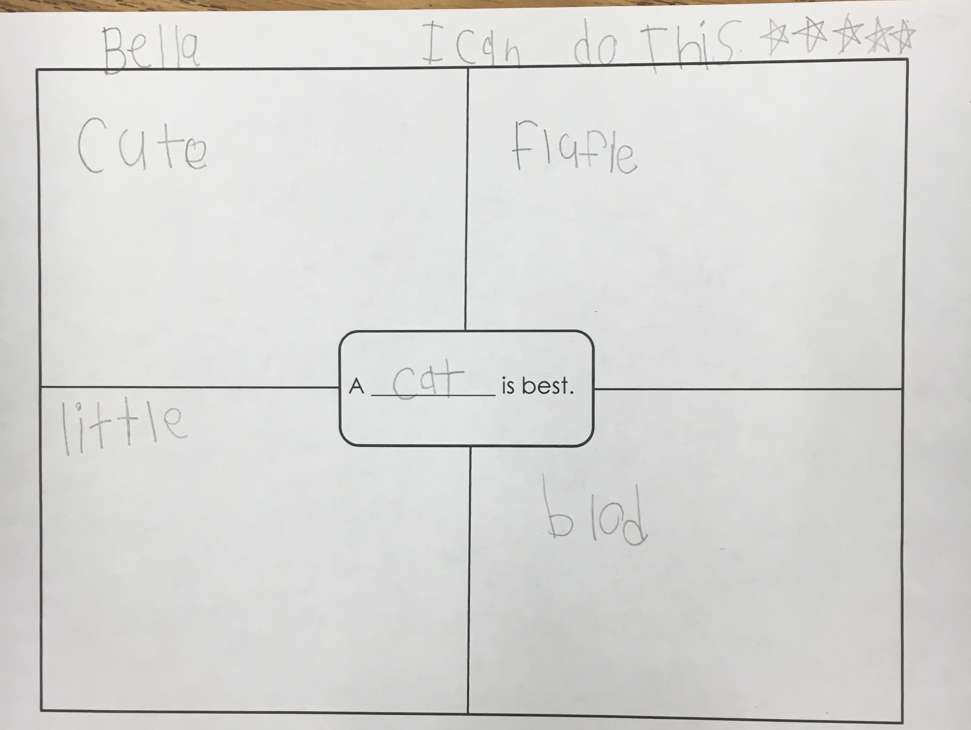
Nurture Self-talk Daily
Notes:
Believe effort matters. Huge for growth mindset! Not fixed – can be helped with practice! Must believe effort is key – must put in effort too or it won’t work w/strategies alone. Must ‘choose’ to galvanize to use these!

Slide 66
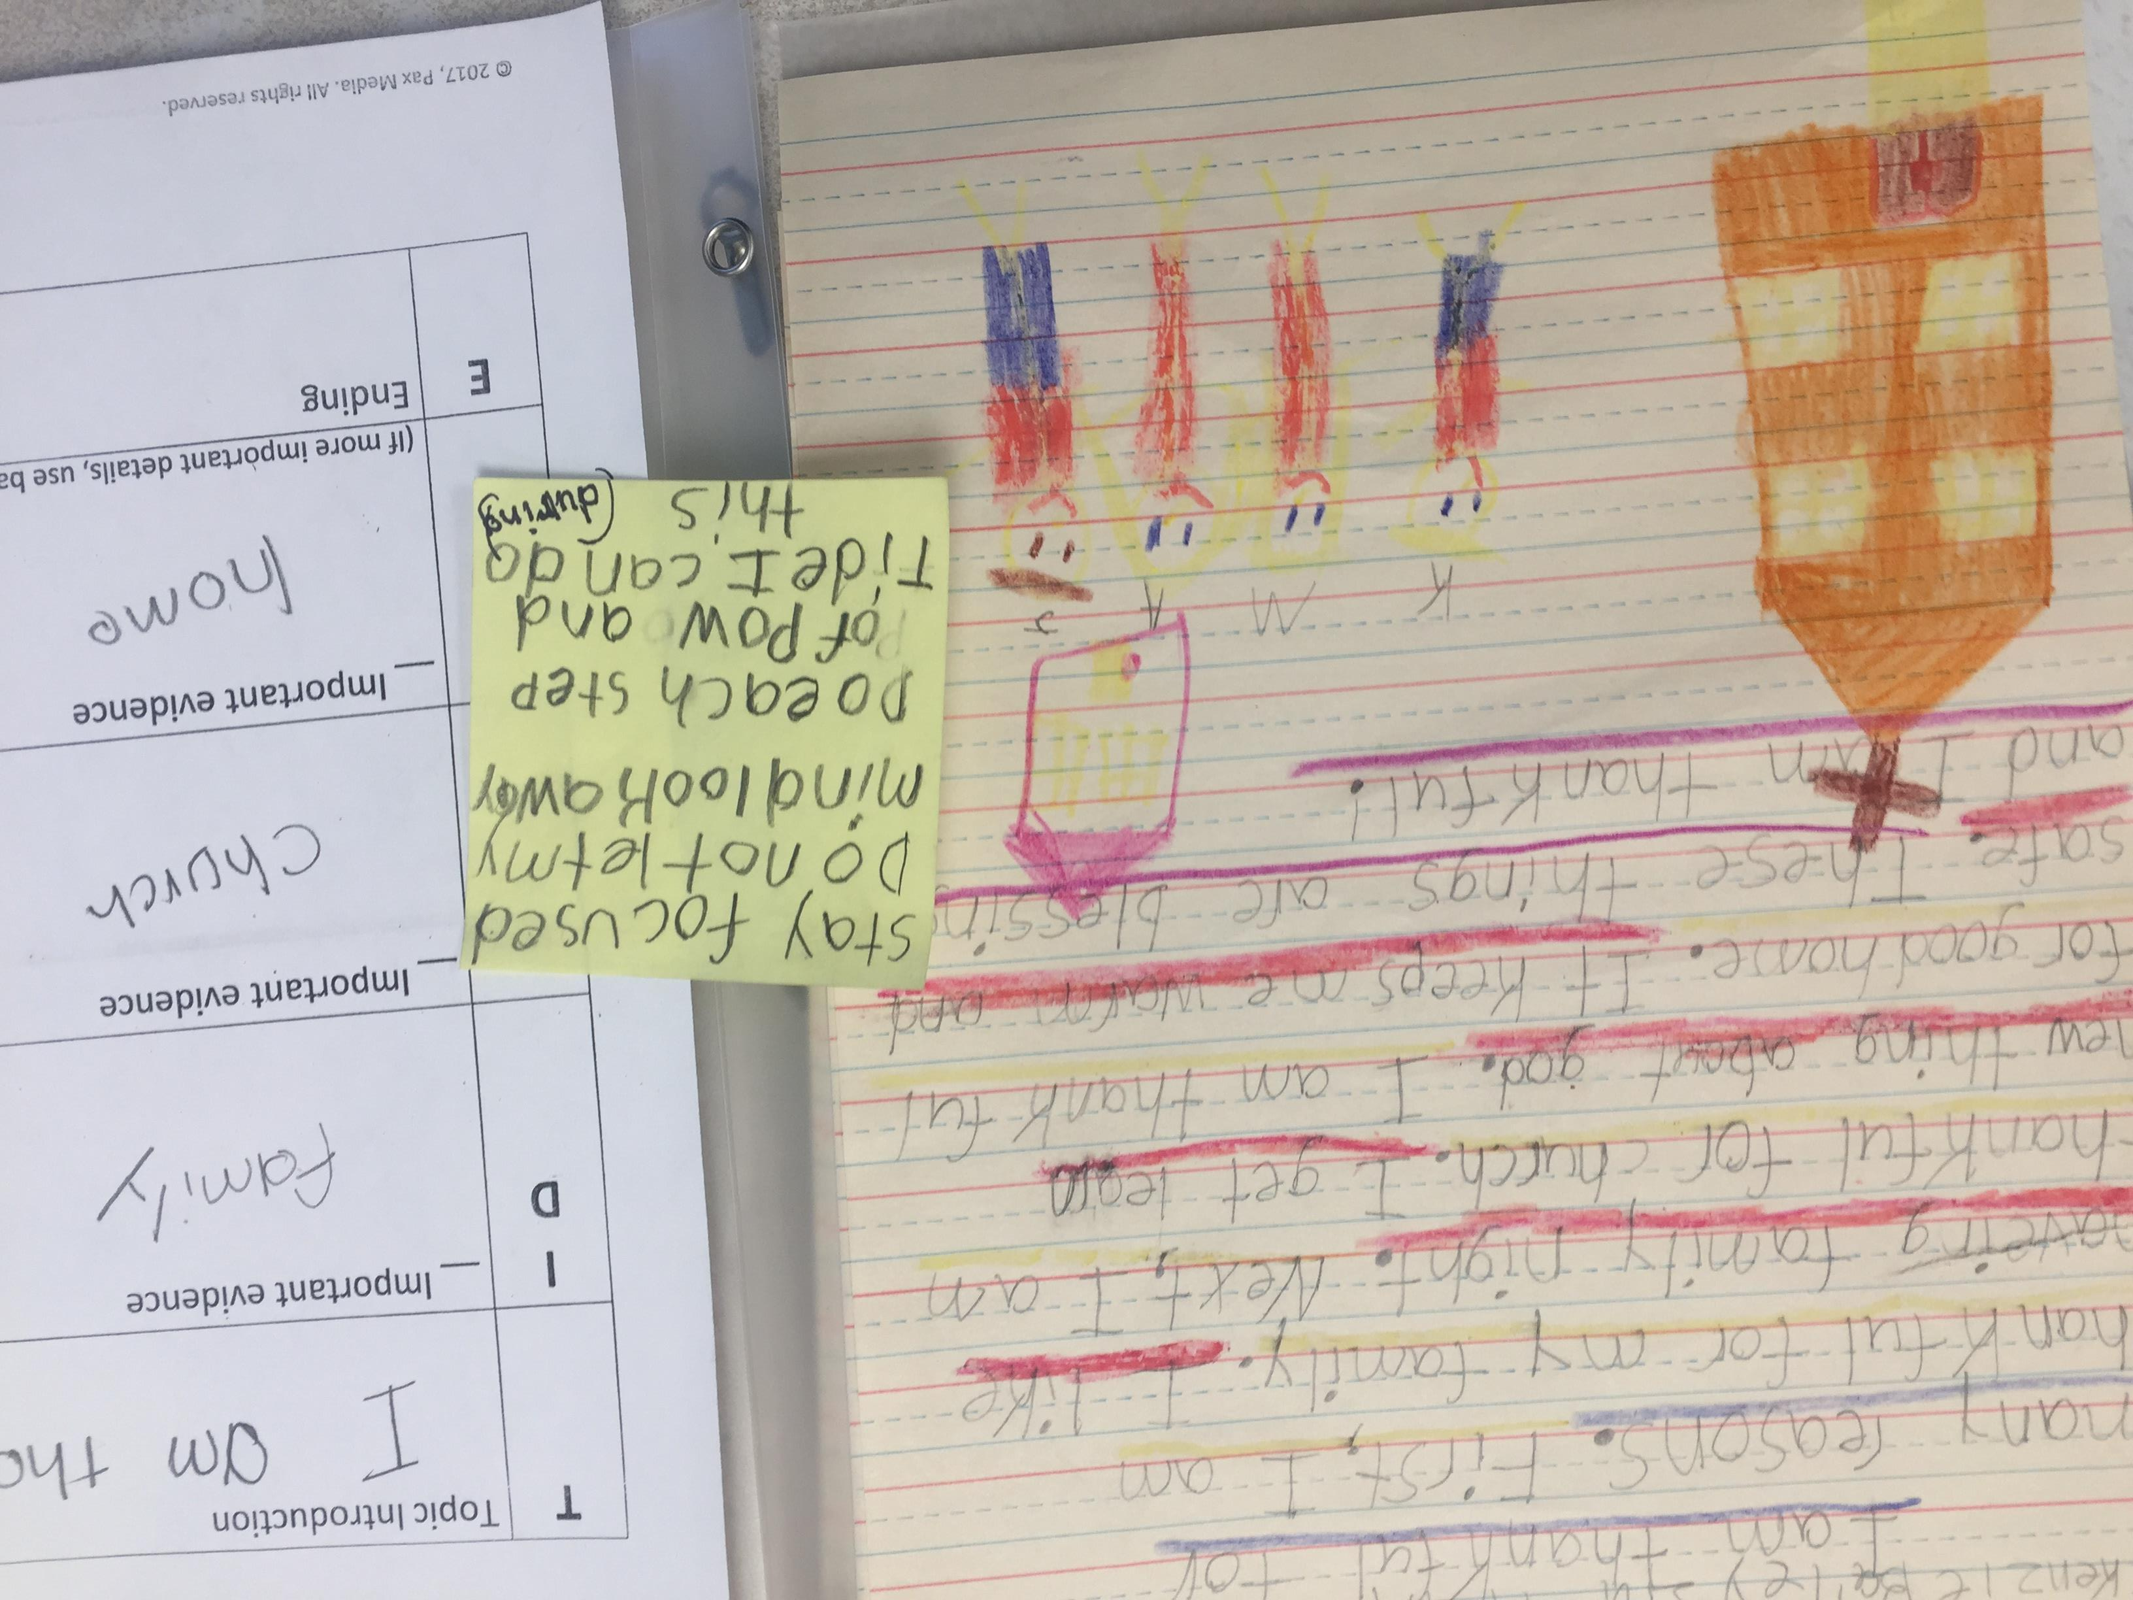

Slide 67
From the Field
“I’ve had two great moments this week and it’s only Tuesday! Yesterday a student said, ‘POW and TIDE make writing an essay so much easier.’ Then today one of my students said, ‘This is the best essay I’ve ever written!’ It has definitely been a game changer. We’re still working on some self-regulation strategies, but overall I am seeing such a HUGE improvement.”
“I'm so happy to say that I'm seeing great improvements with ALL my students since using SRSD. My struggling writers are gaining such confidence....it makes my heart happy!”
“The students really caught on to the ‘Do | What?’ and TIDE portions of the lesson…. They said they liked this process because it makes organizing their writing easier and helps to give them a focus.”
“I started the self-talk strategy with my students and it has spread with them cross-curricular. They are using it in all classes! I’m so excited.
“I also had a student say that they had used the POW TIDE strategies to work on a piece they were writing at home for fun. My students have been very receptive of the strategies...for the most part, lol”
“After mapping our essays out this way, I created a roadmap PowerPoint for each paragraph, and students followed the roadmap and have written one to two paragraph a day! A great chunk of my kiddos have been super successful!”

Slide 68
Pre-test: 4th Grade Early January

Slide 69
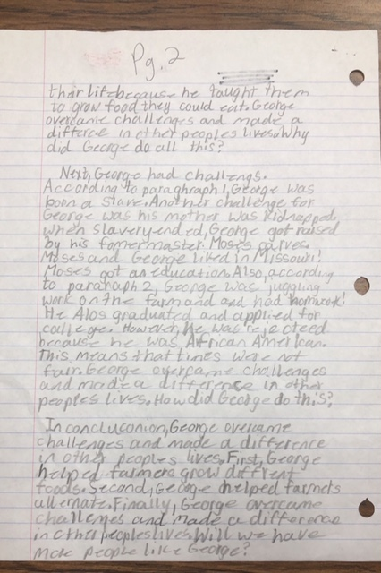
Post-Test: 4th Grade Mid March

Slide 70
More Information
Releasing Writers! Evidence-Based Strategies for Writing Instruction www.thinkSRSD.com
WWC Intervention Report: https://ies.ed.gov/ncee/wwc/EvidenceSnapshot/680
Maggie Luma
Office of Special Education
304-558-2696
myelencsi@k12.wv.us
https://wvde.us/college-and-career-readiness/support-for-ccrs/

